Slide 1
Submental intubation
Dr. S. Parthasarathy
MD, DA, DNB,
Dip Diab.MD , (ACU) Dip software based statistics,
PhD (physiology)
IDRA CUGRA
www.painfreepartha.com

Slide 2
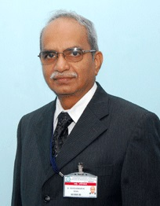
My salute !!
Legendary teacher of two centuries--
Dr. M.Ravishankar

Slide 3
History
Hernandez Altemir, a Maxillofacial surgeon, first described an alternative for tracheostomy in 1986.
Earlier tracheostomy was the option when the dental surgeon wants intra oral access when nasotracheal tube is contraindicated

Slide 4
Definition – what is it ?
The sub‑mental route for endotracheal intubation consists of pulling the free end of an endotracheal tube (universal connector removed) through a sub‑mental incision, after the usual orotracheal intubation has been performed.

Slide 5
Why should we think of such ?
Conventional orotracheal intubation is inappropriate as it interferes with the surgical access.
Temporary intraoperative occlusion of teeth (intramaxillary and maxillomandibular fixation) is needed to check the alignment of the fracture fragments, making orotracheal intubation unsuitable
Tracheostomy is a bigger procedure with more complications

Slide 6
Can we think of nasotracheal intubation
Nasotracheal intubation is not recommended in presence of panfacial fracture, cervical spine injury, skull base fracture with or without cerebrospinal fluid rhinorrhea, systemic coagulation disorders, distorted nasal anatomy
Fibreoptic nasotracheal is suggested by some .. But will local anaesthesia work ?
Will there be bleeding to decrease the chances ?

Slide 7
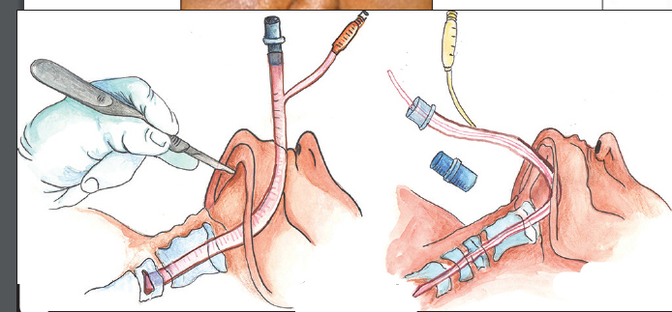
Definition – what is it ?
The sub‑mental route for endotracheal intubation consists of pulling the free end of an endotracheal tube (universal connector removed) through a sub‑mental incision, after the usual orotracheal intubation has been performed.

Slide 8
Indications for submental intubation
Craniofacial traumatic injuries;
Short-term intraoperative intermaxillary fixation required to establish reduction and rigid fixation of fractures;
Large pharyngeal flaps;
combined bimaxillary orthognathic surgeries and rhinoplasty cases.
Submental intubation can be used for surgical access to the pituitary gland from an oral approach

Slide 9
We don’t want tracheostomy
Tracheotomy, an alternative method, has its own complications including hemorrhage,
recurrent laryngeal nerve damage,
subcutaneous emphysema,
tracheal stenosis,
trachea-esophageal fistula, and scarring.
This technique is also esthetically inferior compared with submental intubation

Slide 10
Orodental surgery
Nasotracheal intubation contraindicated
We hesitate doing tracheostomy

Slide 11
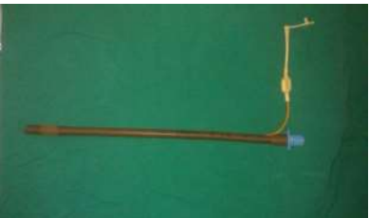
Technique of submental intubation
Flexometallic tube
Can soak in warm water
The adapter should be easily detachable
Two sizes ready
Cuff checked

Slide 12
A normal tube is kept
The black line is painted in the tube
We can have one more line at 25 cm if we want for convenience

Slide 13
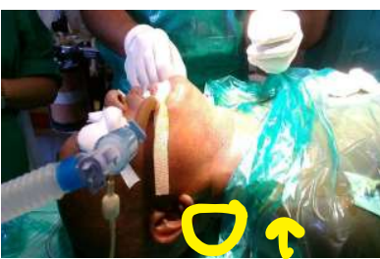
Routine oral intubation

Slide 14
Technique – continued
The curved artery forceps is brought towards the floor of the mouth
The cuff is deflated and the inflating channel is first brought throough the submental incision
The artery forceps is pushed inside again
The assistant removes the adapter swings the tube into the artery forceps
The adapter is connected and ventilated

Slide 15
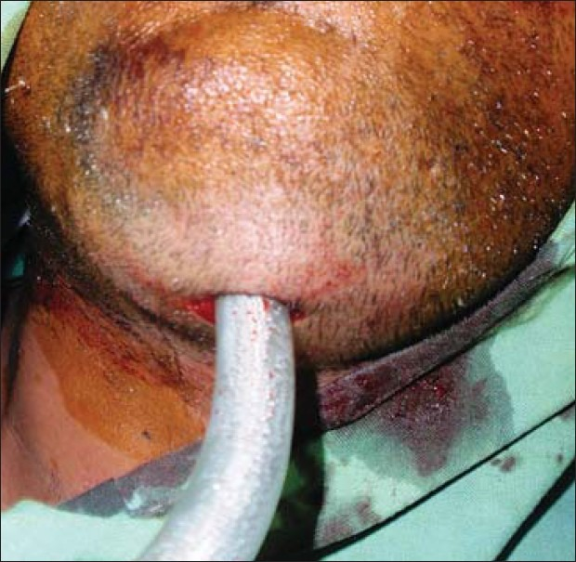

Slide 17
Procedure – summary
Make the tube a little less stiff
Connector loose
Routine oral intubation
Submental incision of around 2 cm
Get a curved forceps through the incision to the floor of the mouth
Deflate the cuff , pick up the inflating channel first and get it out of the incision
Disconnect the ventilator and reconnect to the tube and ventilate

Slide 19
During removal
Once the operative procedure is over the stay sutures across the tube are removed,
the ETT is brought back in to the oral cavity and the skin wound is closed by 3-0 nylon sutures
Can also extubate like that ! If needed
while the intraoral wound was left to heal with secondary intention.
The skin area is infiltrated by 0.5% bupivacaine to decrease post-operative discomfort and a pressure dressing is given on the skin

Slide 20
Modification to counter the problem of inflating channel and tube coming out in different channels
Mersilk – take out the inflation channel
Second forceps – same channel – tube now

Slide 21
Nyárády et al described the “rule of 2-2-2” to remember the main points of the technique for submental intubation.
This involves a 2-cm-long incision that is 2 cm from the midline and 2 cm medial and parallel to the mandibule

Slide 22
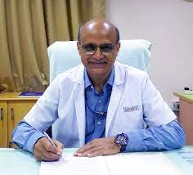
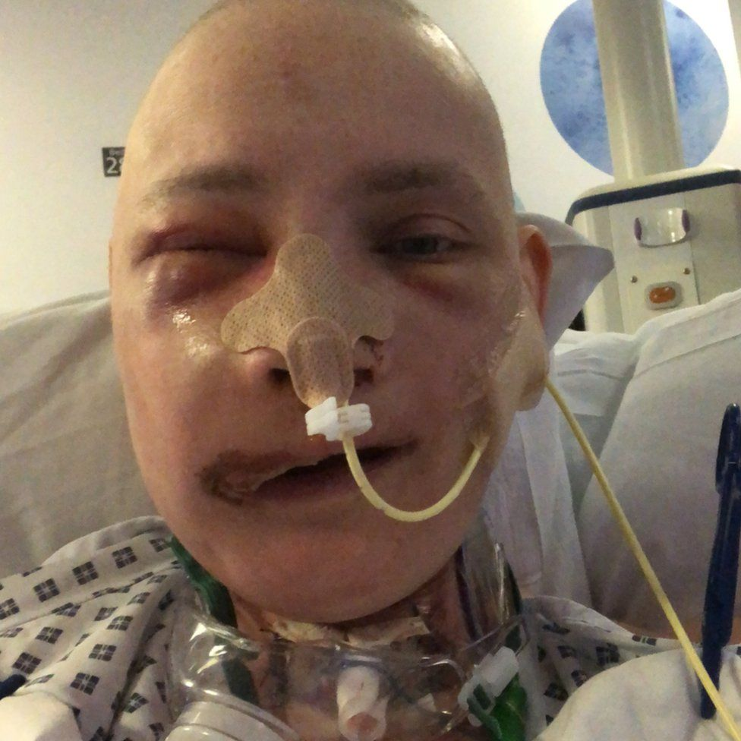
submental diversion
It is usually performed in a patient with normal airway where conventional orotracheal intubation is possible.
Submental diversion is only an intermediate step that offers surgical access in specific surgeries where temporary intraoperative occlusion of teeth that is, intramaxillary and maxillomandibular fixation is needed to check the alignment of the fracture fragments.
It is applicable only in patients in whom anatomy is expected to become normal after the surgery, and
long term post-operative ventilation is not anticipated.

Slide 23
Key issues
Reinforced new tube
Can keep spontaneous during change over and throughthe big hole – agent and oxygen flow is one option
Sterile the proximal part of the tube as it is given to surgeons , it should be very sterile to avoid infection at the site
An assistant who takes care of the proximal end of WR-ETT (wearing sterile gloves) and hands it over to the surgeon is another option

Slide 24
Key issues
A throat pack is applied if necessary.
Capnography
It has specific importance for alerting the anesthesiologist about tube compression, accidental extubation, or endobronchial intubation with jaw movement during surgery.
Airway pressure is monitored peroperatively to detect inadvertent tube compression or deviation.
Can we use hand ventilation for a few minutes prior to disconnection and reconnection ?

Slide 25
Modifications Anterograde and retrograde tubes
In this method, after the spiral tube was inserted orally into the trachea, a submental tunnel was created.
Another tracheal tube was introduced through the submental incision to the floor of the mouth and was subsequently exchanged with the previous tube
Difficult and danger of failure

Slide 26
Modifications
Use of a sterile polypropylene cylinder

Slide 27
Modifications
Lingual nerve
Hypoglossal nerve
Submandibular and sublingual ducts !

Slide 28
Classic midline
Bleeding is less
Transmyelohyoid – better grip on the tube ?

Slide 29
Modifications
A 100% silicon wire reinforced tube primarily intended for intubation through intubating laryngeal mask airway (ILMA) is a better option as it has an easily removable universal connector

Slide 30
More and more modifications
Mahmood and Lello performed submental intubation using preformed Sheridan tube.
The preformed curvature helps in positioning of the tube as it conforms to the anatomy of the region.

Slide 31
Lima et al
The end was covered with a size 8 surgical glove finger to facilitate the passage through the tunnel and prevent entering of blood and soft tissue
tube end and cuff were externalized with the help of an artery forceps

Slide 32
Reinforced LMA
laryngotracheal disruption, voice professionals refusing endotracheal intubation, and patients with unstable cervical fractures posted for faciomaxillary surgery.
However, movement of patient’s head should be very gentle and great care is needed to prevent dislodgement of the LMA

Slide 33
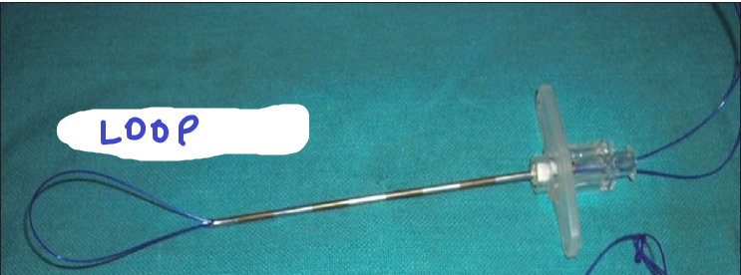
Mouth opening less
Oral anaesthesia
Transtracheal anaesthesia
Incision in submental space
A guide wire inside a 3 mm tube and looped
Pushed in and then the loop is widened
From below the guidewire is introduced into the loop and tightened from the Cricothyroid membrane
Why so much struggle
Avoid tracheostomy

Slide 34
Needle with loop from the submentum
Wire from the cricithyroid retrograde
Conscious patient

Slide 35
Modified !!
Ventilate through either tube which ever is positioned
Combitube through an extended submental route can produce results better than its use trans orally as it permits correction of intraoral structures and the occlusion without the anaesthetic tubes impeding

Slide 36
Problems of submental intubation
Technical difficulty
Inability to ventilate and hypoxia
(Retrieval of tube and reestablishing connection)
Accidental extubation and aspiration
Surgeons compressing the tube
Bleeding from incision site
Can we pass a Ryle’s tube ?

Slide 37
Problems of submental intubation
incidences of superficial infection,
abscess, sepsis,
damage to the lingual nerve, Hypoglossal nerve and ducts
hypertrophic scar,
orocutaneous fistula,
Mucocele
Suction is difficult – Effective lubrication

Slide 38
Problems of submental intubation
The postoperative period may be complicated
airway edema,
obstruction,
hematoma,
Re exploration
ranula formation, hypertrophic scarring,
Better tolerated during extubation than oral tube
But the problem of conversion back to oral tube can tear pilot tubes

Slide 39
Difficulty in taking out the tube through the incision !!

Slide 40
Contraindications:
1. Uncooperative patient
2. Bleeding diathesis
3. Disrupted laryngotracheal anatomy
4. Restricted retromolar space to allow suctioning
5. Inability to pass pharyngeal loop assembly
6. Gun-shot injuries of face
7. Fresh maxillofacial trauma with soft tissue edema
8. Need for prolonged postoperative airway control

Slide 41
Please inform about scar in the preop visit !

Slide 42
Retromolar intubation , tracheostomy and nasotracheal intubations are the options for faciomaxillary surgeries

Slide 43
Reported in kids also

Slide 44
Summary
Thank you all
Long live the ISA
All slides in www.painfreepartha.com
What is it and what for ?
Submental diversion !
Indications
Techniques and modifications
Complications
Contraindications

