Slide 1
Anaesthesia in pediatric cardiac catheterization
Dr. S. Parthasarathy
MD., DA., DNB, MD (Acu),
Dip. Diab., Dip. Software based statistics,
Phd (physio) IDRA CUGRA

Slide 2
Declaration
Pediatric anaesthesiologist
Cardiac anaesthesiologist
??

Slide 3
History
First cardiac catheterization on human was introduced by Werner Forssmann in 1929 who inserted a catheter through his own antecubital vein to the right heart
Diagnostic cardiac catheterization was reported in the nineteenth century and interventional cardiac catheterization was first described by Rubio-Alvarez in 1954 for the treatment of pulmonary valve stenosis.

Slide 5
Interventional techniques
ASD closure
Atrial septal defect closure is the most commonly performed procedure. Trans-esophageal echocardiography (TEE) is used to assess the margins of the defect and to aid X-ray-guided device placement
Dislodgement embolization, impinging and rarely rupture of vessels
VSD closure ( Rare)

Slide 6
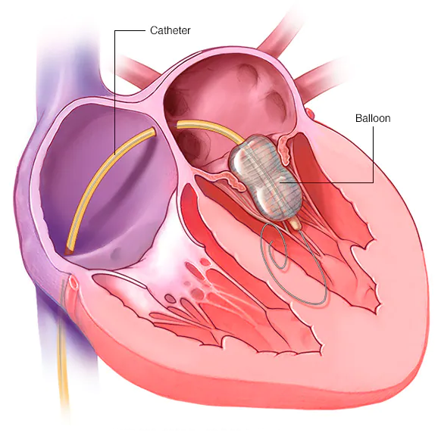
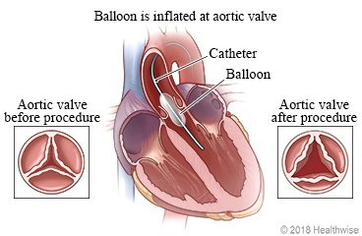
Valvuloplasty
A fluid-filled cardiac catheter is passed across the stenotic pulmonary or aortic valves and the pressure gradient assessed.
This is exchanged over a guide wire for a balloon catheter, which is then inflated for a few seconds to split the fused valve leaflets.

Slide 7
Atrial septostomy
This procedure is performed to allow mixing of blood to improve oxygen saturation in complex cardiac lesions
Angioplasty and placement of stents
branch pulmonary artery stenosis, coarctation of aorta and superior vena cava obstruction.
Closure of systemic to pulmonary shunts
PDA
Hybrid procedure- open the heart and cannulate the pulmonary trunk ! Do stenting

Slide 8
Anaesthesia for cardiac catheterization

Slide 9
Preoperative
Always routine – remember routine
Difficulty feeding, poor growth, sweating in infants or reduced exercise tolerance in older children
Current drugs – ACEI can be stopped ? Diuretics
Anticoagulants – shunt dependent – don’t stop
All other drugs to continue

Slide 10
Initial evaluation
Is the patient cyanotic?
Is there a left-to-right, right-to-left, or mixed shunt?
Is either the pulmonary or systemic circulation dependent upon the ductus?
Is there a pressure or volume overload on any of the cardiac chambers?
What compensatory mechanisms or stabilizing therapies are in place?
What is the current degree of cardiopulmonary reserve?
Is there a risk of deterioration if FIO2 or ventilation is increased?

Slide 11
If the shunt is 1:1
Arterial saturation of 75 to 85 may be acceptable in infants
Saturation , pulse and blood pressure in both arms

Slide 12
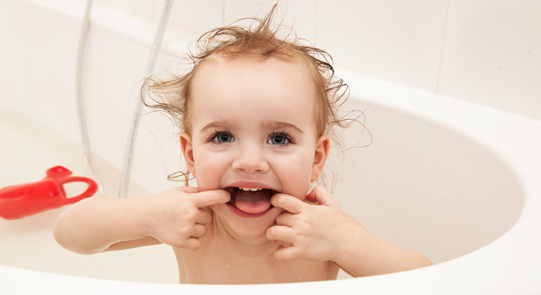
Preoperative work up
Airway abnormalities,
bronchospasm, gastroesophageal reflux, and issues pertaining to vascular access.
Fasting guidelines
Other disease
Cleft lip etc.
Remember the teeth !

Slide 13
Preop
Ask with cardiologist – what is his plan ? Procedure and access !
Rule out recent URI
musculoskeletal abnormality
neurological defects
genitourinary irregularities
One congenital lesion that needs particular attention is the atlanto-occipital subluxation that occurs in 20% of patients with Down’s syndrome.

Slide 14
Investigations
Previous anaesthesia charts
ECG and a recent echocardiography and MRI reports should be reviewed along with routine laboratory studies,
including full blood count,
creatinine, urea and electrolytes
Cardiac OT should be ready in emergencies

Slide 15
What to see in ECHO ??
Presence of the flow obstruction (degree of obstruction or pressure gradient) and level of obstruction
Pressure gradient across the valves and intracardiac communications.
Presence and direction of the shunt
Rule out suprasystemic pressures in the chambers of the heart

Slide 16
Beware of Hb
Patient with cyanotic CHD having a haemoglobin (Hb) level > 20 gm/dL or haematocrit >65% may have hyperviscosity, RBC sludging, and reduced oxygen delivery to tissues which may further exaggerate in dehydrated patients and after hypothermia during the procedure

Slide 17
Patients with polycythemia and cyanosis may also have thrombocytopenia, hypofibrinogenemia, and low levels of vitamin K dependent clotting factors.
If Hb is more than 18 or 20 – go for PT INR and aptt

Slide 18
Premedication
Premedication is not commonly used but may benefit anxious older children particularly who may have had multiple procedures.
Clearly safety must be considered in the smaller, more cyanotic children or those with poor ventricular function.
Midazolam up to 0.5 mg /kg orally (up to a maximum 20 mg)
Parental presence,
distraction techniques
and assistance of play therapists are alternative means of reducing anxiety.

Slide 19
Cath lab problems
The anaesthesiologist who is more comfortable in the operation theatre often describes the environment of the cath. Lab. as “unknown”.
Access to the patient is difficult due to fluoroscopy equipment all around the patient with dimmed light and movable tables.
Anaesthesiologist must be assured easy access to the patient and in particular to the patient’s airway.

Slide 20
General anesthesia – pros and cons
Immobile
Fear nil
May cooperate
for next procedures
Airway secure
PETCO2 control
venodilation, decreased SVR and myocardial depression,
They may interfere with measurements
Positive pressure ventilation reduces venous return, altering the flow across valves and shunts, and decreases the metabolic rate, decreasing oxygen consumption, further altering hemodynamics

Slide 21
Agents
Sevoflurane is OK
But with side effects
Nitrous has two problems –
air embolism
Pulmonary hypertension
remifentanil offers stability and rapid titration, but can adversely affect electrophysiologic studies by slowing both sinus and atrioventricular nodal function when given in moderate to high dose infusions

Slide 22
Induction
IV access possible but not cooperating – sevoflurane induction
Otherwise ketamine or etomidate or propofol
Understand the disease
Understand the cardiac grid
Pulse rate , contractility , importance of rhythm
SVR, PVR etc.
Clonidine has also ben used instead of midazolam
Dexmedetomidine is usually used in combination with another sedative drug, such as ketamine

Slide 23
Can we add ??
Propofol
there is less emergence delirium, nausea and vomiting, and more rapid recovery. It has no effect on PVR or pulmonary artery pressure (PAP)
, but can decrease blood pressure, heart rate, SVR and cardiac contractility
Ketamine
It serves as an anxiolytic, analgesic and sedative-hypnotic, while preserving airway reflexes and ventilation.
Disadvantages include increased salivation, dysphoria, prolonged wake-up/recovery, nausea and non-purposeful movements.

Slide 24
Intubate
Preferable controlled ventilation
Tube or SGA in short case especially older children
0.5 mg / Kg of atracurium
Cuffed tubes and avoid leaks
Understand hypercarbia and shunts
FiO2 25 % ? Does the cardiologist measure saturation of blood in chambers ?
Central access and arterial access is usually reserved for sicker children (e.g. critical aortic stenosis in neonates) but the need should be assessed on a case-by-case basis

Slide 25
Perioperative
Supine patient
Arms over the head
Cables not interfering with C Arm
Be secure with ETT and IV access
Expandable breathing circuits
intravenous tube extensions.
Lead aprons
Sometimes we are out away from the patient
Protection of eyes and temperature control

Slide 26
A wedge under the hip may ease your femoral access but
We need to think about respiration and remove it

Slide 27
Intraoperative
Radiation dose is monitored and minimized as far as possible. Lead
gowns may cover areas of the body not being scanned
Try to become familiar with lead gowns
Fentanyl
Paracetamol
Ondansetron
Air oxygen sevo

Slide 28
Intraoperative
Isotonic i.v. maintenance fluid will be required in the vast majority of cases
attention to blood sugar monitoring in neonates
Consider flush solutions
Deairing
Are any nephrotoxic drugs used ?

Slide 29
Electrophysiological studies
Most of the children presenting for EP studies are otherwise healthy with a normal functioning heart and suffer from uncomplicated supraventricular tachycardia.
The technique involves passage of electrode catheters to the right heart and coronary sinus through femoral venous access.
Prolonged procedure
May give less agents to avoid suppression of ectopic foci

Slide 30
Agents
The speed of anaesthetic induction in patients with CHD is affected by factors such as intracardiac shunts, pulmonary blood flow, cardiac output and the blood gas solubility of the anaesthetic agent
Patients with right-left shunt demonstrate more rapid induction, as some of the anaesthetic bypasses the pulmonary circuit to reach the brain.
Conversely, in patients with left-right shunt, a slower onset is observed because of dilution of the agent by recirculating blood.

Slide 31
Does IPPV affect pressure monitoring ?
There are a lot of controversies
We should understand the disease
After induction – there may be variations , but after stabilizing on intubation , not much changes in pressures – one tehran study
pt’s cardiopulmonary physiology has to be as close to the baseline (awake state) as possible in order to obtain real data from the procedure.

Slide 32
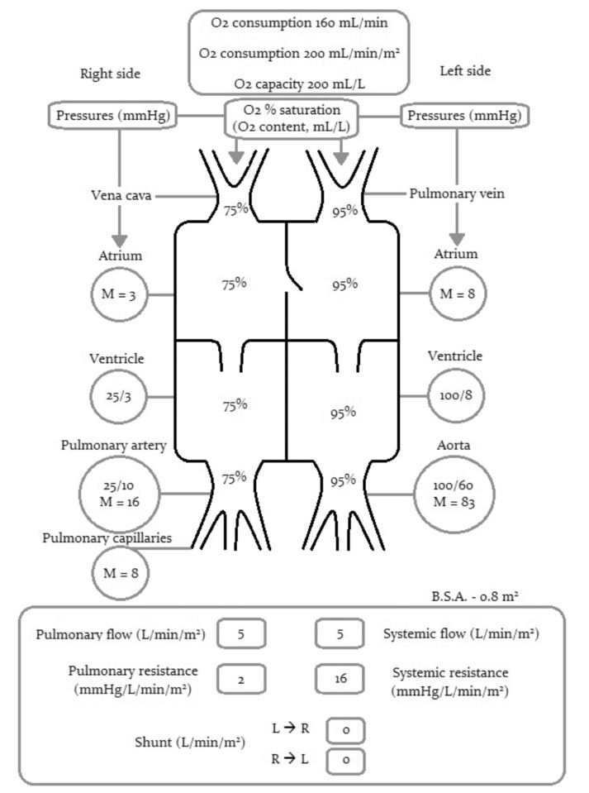

Slide 33
Post operative
Routine extubation with femoral puncture sites observation
Sudden increase in SVR after PDA closure – beware
No big post op pain
Better not to move much
Compression of puncture site

Slide 34
Complications- The overall incidence of complications in paediatric cardiac catheterization is quoted at 7.3%,
Air embolism
Choking cough
Laryngospasm and bronchospasm
Far away from fields –
‘
Hypothermia
haemorrhage, retroperitoneal and local haematoma, pseudo-aneurysm, arterio-venous fistula, neuropathy and thrombosis leading to lower limb ischaemia
Vascular injuries
Hypotension
Embolization
Arrythmias

Slide 35
What is ideal ?
Immobile
Spontaneous breathing
Normal respiratory pattern
Hemodynamics stable
No extra oxygen
No anxiety
But good recovery !!
No nociception
No blood loss
No visceral pain and manipulation
Make immobile !

Slide 36
Summary
Indications --- History of the patient – assess
Investigations
Hemoglobin
Talk with cardiologist
Premedication and monitoring
Remote location concerns – sedation or anaesthesia
FiO2
Temperature and hydration
Keep as preop – agents ?
Blood sugar and deairing
Extubate as routine – complications
Thank you all

