Slide 1
Ryle’s tube
Dr. S. Parthasarathy MD., DA., DNB.,
PhD. FICA , IDRA,
Diploma in software based statistics - CUGRA
Professor – Mahatma Gandhi Medical college and research institute – Pondicherry
Associate editor IJA

Slide 2
History
Ryle's tube (rylz) - a thin flexible tube of rubber or plastic, which is inserted into the stomach through the mouth or nose of a patient and is used for withdrawing fluid from the stomach or for giving a test meal. [ J. A. Ryle (1889–1950), British physician]
Search for the inventor of Nasogastric tube -- ? Abraham Levin

Slide 3
Indications
Therapeutic –
Diagnostic
Prophylactic
Monitoring
Feeding
drugs , GI bleeds, poisons, hypothermia
TOF, GI bleeds ,
prevent aspiration
Gut obstruction – conservative
NG tubes – 3 months feeding

Slide 4
Contraindications
Mid face injury
Coagulation failure
Esophageal surgeries
Recent throat surgeries
Alkaline ingestion = to be careful

Slide 5
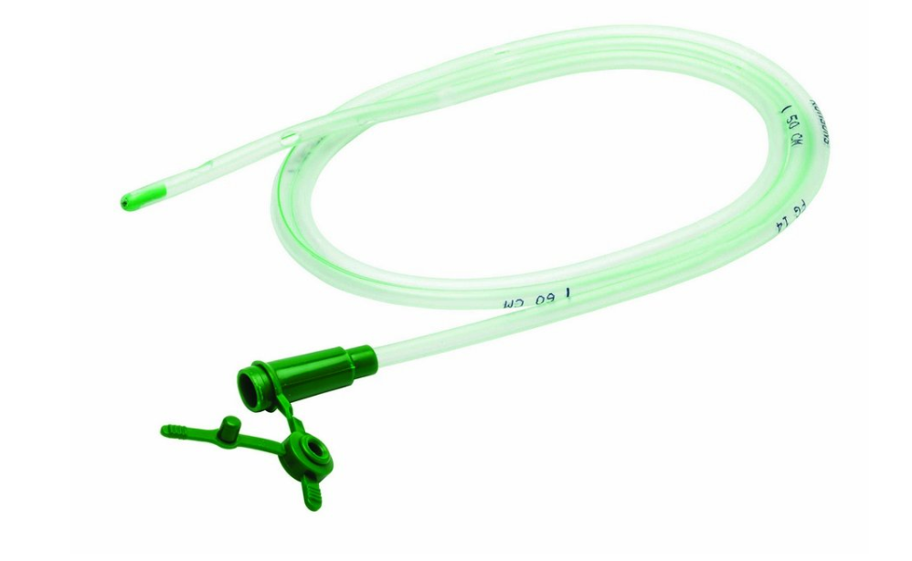
Parts of a ryle’s tube
Tip blunted and heavy and four lateral eyes
May be coned with steel balls
The tube – 50 – 60 – 70 inches markings
Base or the connector for the syringe/suction
Radio opaque line

Slide 6
Sizes
4 FG 6 FG, 8 FG, 10 FG, 12 FG, 14 FG, 16 FG, 18 FG, 20 FG
22. 24 size NGT tubes- rarely used
Neonatal – 4 – 6
Pediatrics - (Age + 8) $÷$ 2
8 years means 16/ 2 = 8 FG approx.
Adults – 16 – 18 usual
The length varies from 29 – 50 inches

Slide 7
Color coded ? Followed ?

Slide 8
What are they made of ?
Rubber
PVC = 2 - 3 weeks
Polyurethane – 10 days - may be more

Slide 9
Technique of insertion
Preparation
Ryle tube can be kept in the fridge and then removed to insert to stiffen
Lignocaine gel in the tip may be upto 10 cm
Fowler position
Nose and mouth betadine wash
Lignocaine gel in the nose
No dentures
Water with straw

Slide 10
Patient explanation
Tape
Emesis basin or plastic bag
Wall suction, set to low intermittent suction
Suction tubing and container
Toomy syringe

Slide 11
Local techniques
Sniff and swallow – lignocaine
Nebulize
Atomize

Slide 12
Which position ??
Fowler's position is a standard patient position in which the patient is seated in a semi-sitting position (45-60 degrees) and may have knees either bent or straight.
Semi fowler
Proved to easier insertion than supine
Lateral position better than supine in unconscious patients without instruments
Blow through the nose to find out which nostril is patent

Slide 13
Start vertical from tip of the nose
Go in to hit the resistance
Move some more with swallowing
When they gag – swallow
After it crosses the pharynx and enters esophagus the path is usually easy
See for coiling in the mouth
Hanson ([NEX – 50 cm]/2) + 50 cm
Nex

Slide 14
Outward and rightward pull of trachea externally at cricoid level (Samanta and Ghatak’s technique).

Slide 15
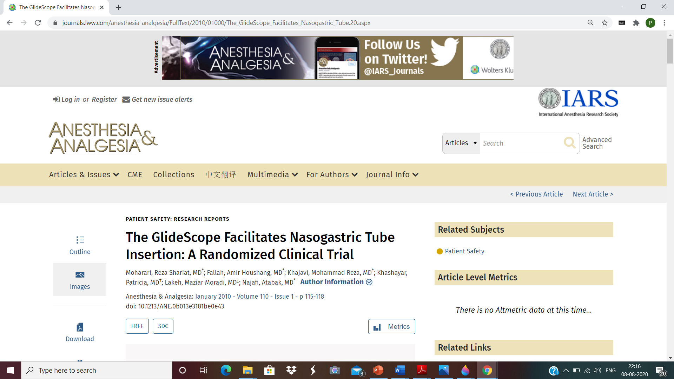
Other techniques
Novel Visual Nasogastric Tube Insertion System:
Fiber with NGT – scopes
Reverse sellick manouver
Kink and the memory effect of kinking

Slide 16
During anesthesia 50 % success Vs more than 80 % in unintubated patients
The most common sites of impaction of the NG tube are piriform sinuses and the arytenoid cartilage
slit endotracheal tube,
forward displacement of the larynx and the use of various forceps, the use of an ureteral guidewire as a stylet, head flexion, lateral neck pressure, and the use of a gloved finger to steer the NG tube after impaction

Slide 17
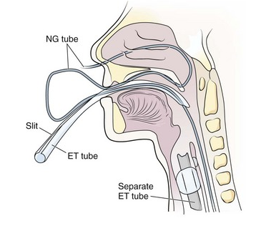
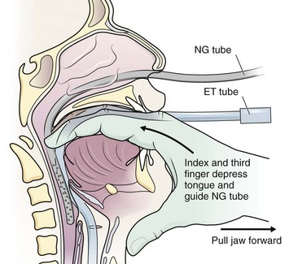

Slide 18
How to check the tube ?
The whoosh test consists of rapidly injecting air down a nasogastric tube while auscultating (listening for a ‘whooshing sound’) over the epigastrium. ? 20 % false
Signs of respiratory distress , cough
Aspirates of stomach
Capnometry
Xray

Slide 19
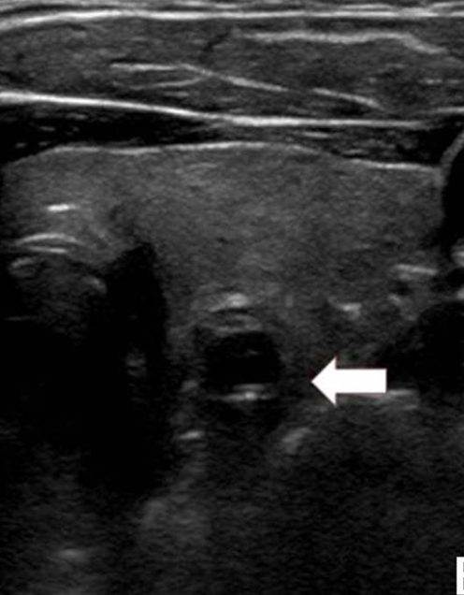
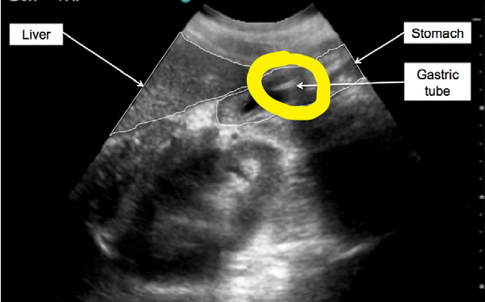
The Kangaroo™ feeding tube is a small- opening single use, disposable feeding tube which has an integrated real-time imaging system (IRIS)
Other tests
pH < 5
Pepsin content
Ultrasound

Slide 20
Fix the tube
The commonly used techniques includes
adhesive,
clips,
safety pins
suture to secure the NG tube

Slide 21
Monitoring
Position – cm.
Coiling
Aspirate
Patient may be lying on the tube

Slide 22
Complications
Pharyngeal discomfort
Erosion of nares ( lubricate)
Sinusitis ( aseptic precautions)
Gastritis ( frequent changing)
Epistaxis
NGT syndrome – arytenoid dysfunction respiratory distress
Beyond the pylorus – or OG junction
Tube breakage

Slide 23
Complications
• Problems that occur when putting in the NG tube include choking, coughing, trouble breathing and turning pale.
• Problems that occur during feeding can include vomiting and stomach bloating.
• Sometimes the NG tube may have moved and the mark you made on it is no longer at the nostril

Slide 24
Complications
Malpositioning of the NG tube into the trachea is a common complication of NG tube passage even among experienced medical practitioners
9900 ryles tube insertion around 150 were in the trachea !

Slide 25
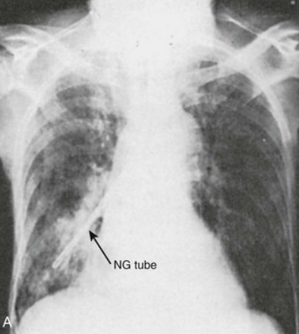
Reports of such intracranial, endobronchial malposition ?
Pneumonia,collapse
pleural entry
Bronchial rupture
Aberrant right subclavian vessels

Slide 26
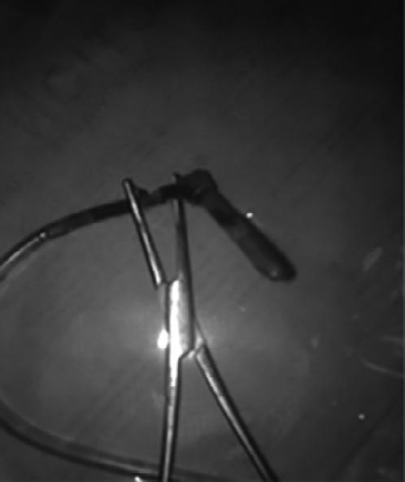
Complications
Psychological trauma
Strict to his bed
Knotted

Slide 27
Summary
Inventor -
Indications
Contraindications
Sizes – color
Technique
Check , fix and monitor
Complications

