Slide 1
Anesthetic concerns in retained placenta
Dr. S. Parthasarathy
MD., DA., DNB, MD (Acu),
Dip. Diab. DCA, Dip. Software statistics- Phd (physio)
IDRA CUGRA

Slide 2
What is this ?
After the birth of the baby , placenta will separate and deliver
Usually it takes 30 minutes to maximum
If it does not deliver , retained placenta should be thought of
But be ready with anesthetist call and blood in twenty minutes
Normal without any intervention - maximum time of 60 minutes is allowed

Slide 3
maternal signs - separation
Let the physiology take its course
Uterus rises in maternal abdomen
Uterine shape changes from discoid to globular
Umbilical cord lengthens
Vaginal blood loss
Active
Supra pubic pressure
Oxytocic
Minimal cord pull
Possible – umbilical vein oxytocin

Slide 4
Incidence is 2 % of deliveries
Mortality is 10 % of the 2 % incidence
Reports of lesser mortality is also there

Slide 5
When we should be ready ?
Risk factors for retained placenta include
history of retained placenta,
preterm
delivery,
oxytocin use during labor,
preeclampsia, - still birth ( placental underperfusion – cause)
Previous scar in the uterus
Atonic uterus
H/O IVF conception

Slide 6
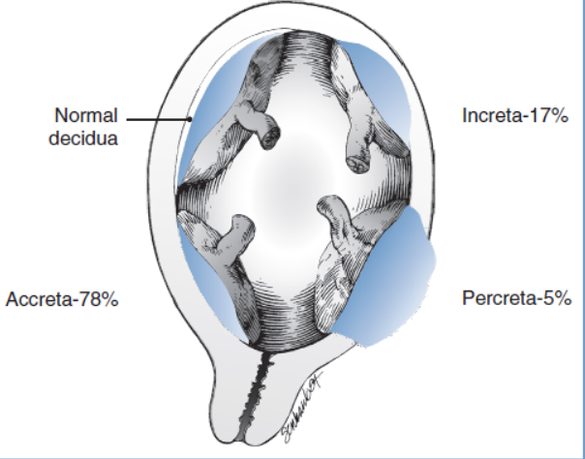
Normal and the abnormal placentae

Slide 7
13 % may require transfusions
Ready for MROP
Blood
Antibiotics
Oxytocin umbilical vein
Ready for inversion and shock
Two IV lines
Oxygen and emergency equipment ready

Slide 8
What investigations do you want
Hb
Blood grouping typing
Cross match and blood and products availability
Others – secondary

Slide 9
Anaesthesia concerns
Usually mild sedatives and analgesics are only needed with a skilled og-cian
Fentanyl 100 mic and 2 mg midaz is all that needed . wait for 2 -3 minutes
Already labour epidural is there – additional doses
8 ml of 1.5 % lignocaine is usually sufficient – need lithotomy

Slide 10
Regional Vs GA
Hemodynamically stable patients
– administer spinal with or without narcotics
Hemodynamically unstable
Fasting ? Any other problem ?
RSI with ketamine supplementation
Endotracheal tube insertion

Slide 11
Inhalational agents ? Isoflurane – a little less invitro
Uterine contractility is decreased by 50% with administration of approximately 1.5 minimum alveolar concentration (MAC) of a volatile anesthetic agent.
The induction of general anesthesia and administration of a volatile agent results in rapid onset of uterine relaxation.
discontinuation of the volatile agent results in rapid offset when uterine relaxation is no longer necessary.

Slide 12
In a study of 15 parturients with NTG
successful removal of retained placenta in 15 parturients
after administration of intravenous nitroglycerin 500 μg.
Sublingual NTG – described

Slide 13
Obstetric procedures
Simple removal
Curettage
Balloon tamponade in case of excess bleeding
Hysteroscopic removal
Rarely internal iliac artery ligation and hysterectomy

Slide 14
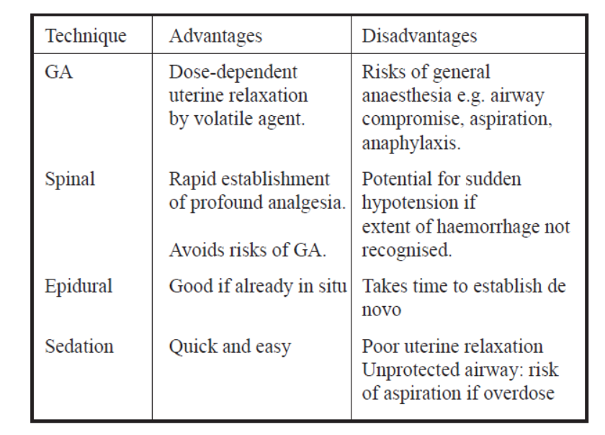
Pros and cons of different technique

Slide 15
Summary
Definition
Risk factors
Bleeding and ready for cross match
Procedure
Sedation /spinal
Epidural / controlled GA
Tocolytics – followed by oxytocics.

Slide 16
Next topic but related - Uterine inversion
Uterine inversion, or the turning inside-out of all or part of the uterus, is a rare but potentially disastrous event---
1 in 2500
Usually acute cases ( within 24 hours) we are more worried
We may be more worried about retained placenta
But partial inversion is missed

Slide 17
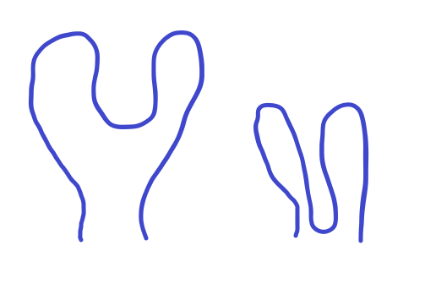
Degrees of inversion
1st degree (also called incomplete) – The fundus is within the endometrial cavity
2nd degree (also called complete) – The fundus protrudes through the cervical os
3rd degree (also called prolapsed) – The fundus protrudes to or beyond the introitus
4th degree (also called total) – Both the uterus and vagina are inverted

Slide 18
Clinical features
Excess bleeds and a mass
Shock
Hypovolemic but disproportionate
Parasympathetic excess and bradycardia
Fundal dip
USG – shows a mass inside the uterus

Slide 19
Risk factors - expect an inversion ??
short umbilical cord,
uterine anomalies,
aggressive management of the third stage of labor,
maneuvers such as inappropriate fundal pressure or
excessive umbilical cord traction

Slide 20
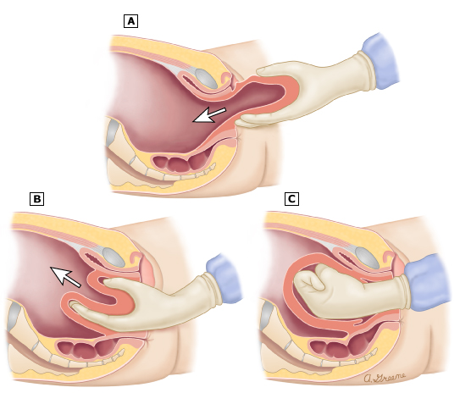
Reduction and reposition !!

Slide 21
What to do with inversion
Immediate replacement is the order of the day
Put the uterus back rather than taking the placenta out
Stop all oxytocics
Get the uterus relaxed
Use liberal NTG
Support with IV fluids and vasopressors

Slide 22
Alternatives to NTG
Terbutaline (0.25 milligrams intravenously or subcutaneously)
magnesium sulfate (4 to 6 grams intravenously over 15 to 20 minutes) are other options for uterine relaxation.
Blood transfusion ready
Inj, tranexamic acid 1gm IV

Slide 23
Management
Controlled GA –
Halogenated agent
IV fluids
NTG
Blood loss correction
Antibiotics
Prepare for a laparotomy
RSI keta suxa tube - agent – then push the uterus in

Slide 24
Management
Haultain procedure - removing the constricting ring in the cervix
Hydrostatic treatment
Vacuum treatment
Hold it in place
Uterotonics

Slide 25
Inversion recur ?
Majority – no
Not exactly known
Risk factors

Slide 26
Summary
Crystalloid bolus , NTG
Don’t attempt to remove placenta
Stop all oxytocics
Attempt manual reduction
Interim period – ask for blood and anesthesia ready
Failed reduction – unstable patient
Coagulation status -
GA with agents – intubation
Try Manual reduction
Failure - Other procedures
1 in 2500
Risk factors
Clinical features
Investigations
Treatment
Anesthesia
Hold the reverted uterus
Thank you all

