Slide 1
Anesthetic management of a patient presenting with eclampsia
Dr. S. Parthasarathy
MD., DA., DNB, MD (Acu), Dip. Diab.
DCA, Dip. Software statistics
PhD ( physiology) – IDRA, FICA

Slide 2
Definition !!
Eclampsia is defined as the occurrence of one or more generalized convulsions and/or coma in the setting of pre-eclampsia and in the absence of other neurologic conditions before, during, or after labor
Pregnant woman – throws fit – think of eclampsia unless proved otherwise
Late eclampsia – within 4 weeks post partum

Slide 3
Incidence !
In India, reported incidence of eclampsia varies from 0.179 to 3.7 %
And maternal mortality varies from 2.2 to 23 % of all eclamptic women
The estimated incidence of eclampsia in Western countries is 1 in 2000–3448 deliveries
Perinatal mortality – 24 – 48 % in India

Slide 4
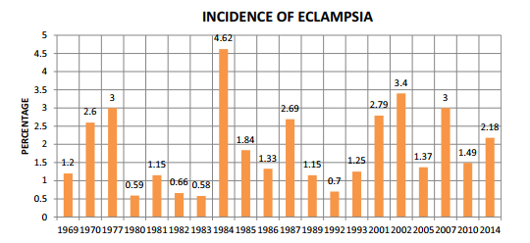
Not much change over the years- India
Internet picture for closed academic purpose only
50 % antenatal, 30 % during labour , 20 % after delivery

Slide 5
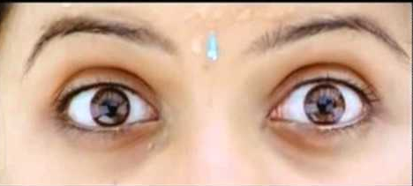
Greek meaning of eclampsia is fancied perception of flashes of light, as the entity is associated with visual disturbances.

Slide 6
Factors which may promote
Young primigravidas,
illiteracy,
lack of adequate antenatal care
low economic conditions.
Molar pregnancy
Multiple pregnancy
SLE
Renal disease

Slide 7
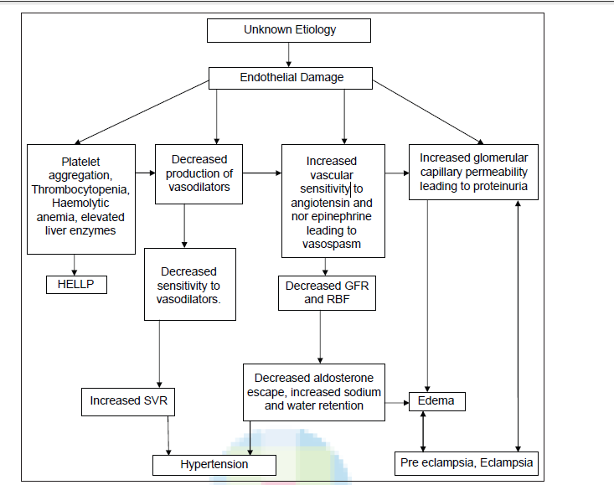
From the internet for closed academic purpose only

Slide 8
What happens before eclampsia ?
There is a loss of autoregulation of cerebral blood flow (CBF) (60-120 mmHg) causing increased CBF making some segments of vessels dilated, ischemic, and increasingly permeable.
Cerebral vasospasm, ischemia, edema, hemorrhage, and hypertensive encephalopathy are probably associated in pathogenesis

Slide 9
Clinical features
Preclampsia + fits = eclampsia
Abrupt onset – rarely the first hypertensive episode
Facial congestion, twitching , froth ( 20 seconds )
Tonic clonic phases of convulsion ( 1 -2 minutes)
Stertorous respiration Variable time of coma
Aspiration is the danger !

Slide 10
Diagnosis
Clinical and the setting
Imaging and EEG – no role
Probably to rule out other causes !

Slide 11
Differential diagnosis
epilepsy,
Cerebral infarction,
cerebral hemorrhage,
subarachnoid hemorrhage,
cerebral venous thrombosis,
Cerebral edema,
malignant hypertension,
benign and malignant cerebral tumors, cerebral abscess,
viral, bacterial, parasitic infestations,
hyponatremia, hypocalcemia, hypoglycemia, Hyperglycemia

Slide 12
Role of imaging
Imaging is not necessary, as neurological abnormalities are transient in most cases.
Yes – some role here
focal neurologic signs,
Atypical seizures, and/or delayed recovery

Slide 13
A common finding in eclampsia is posterior reversible leukoencephalopathy syndrome (PRES),
vasogenic edema in the posterior cerebral circulation, a finding also seen in hypertensive encephalopathy
But more severe

Slide 14
Complications
HELLP syndrome,
abruptio placentae,
DIC, pulmonary edema, renal failure
cardiac arrest
aspiration pneumonitis
neurologic deficits
intrauterine growth retardation,

Slide 15
What is our role ??
control and prevent further convulsions,
control blood pressure,
establish a clear airway,
prevent major complications,
to provide labor analgesia
provide anesthesia for cesarean section

Slide 16
Seizures – magsulf !
In IV regimen (Zuspan) MgSO4 is given as 4 g IV bolus followed by 1-2 g/h as infusion.
I use 1 gm / kg / hour till 48 hours after the last convulsion and withdraw over a period of 4- 6 hours
Lucas , suman sardesai
Charles
> 10 grams in 15 minutes – high doses
< 10 gframs in fifteen minutes – low dose regimen

Slide 17
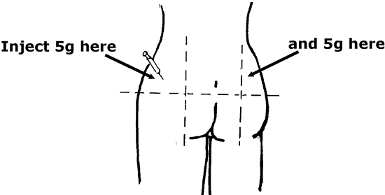
In IM regimen (Pritchard) 4 g of 20% MgSO4 IV and 10 g of 50% MgSO4 IM followed by 5 g IM every 4 h.
Take one 20 ml syringe
Draw 4 ampoules of
Magnesium sulfate
Add 12 ml Normal saline
If convulsion persists one more shot of 2 grams 20 % IV dose

Slide 18
If seizures continue despite a further bolus of magnesium sulfate,
treat with phenytoin (15 mg/kg) or
diazepam (10 mg) or
thiopentone (50 mg IV).
In renal failure , careful titration of the dose is necessary !
Intubate and ventilate if needed -

Slide 19
Loss of patellar reflex is the 1st sign of Magnesium toxicity.
The therapeutic level of serum magnesium is 4-7 mEq/l.
Serum levels of Magnesium toxicity:
8-12 mEq/l: Loss of patellar reflex, flushing, warmth, somnolence, slurred speech
15-17 mEq/l: Muscular paralysis, Respiratory difficulty
30-35 mEq/l: Cardiac arrest

Slide 20
Antihypertensives
Labetolol – 20, 40, upto 220 mg IV
What I do – 5 mg IV bolus followed by 5- 10 mg IM 4-6 hourly
Check the heart rate if not on nifidepine also !
Asthmatics – beware !

Slide 21
Hydralazine 5-10 mg every 20 min to a max dose 20 mg
Oral nifedipine 10 – 20 mg can go up to 50 / day
No sublingual

Slide 22
Preanesthetic evaluation !
Routine but
Think of
Airway edema and size of tubes
Hypoalbuminea
Magsulf and Nodepolarizers
Response to airway manipulation
LFT, Coagulation and renal profiles
Cardiovascular status

Slide 23
Management of labour pain
Epidural analgesia is possible in conscious eclamptic women with no evidence of increased ICP or coagulopathy and whose seizures have been well controlled.
Avoid epidural if neurologic deficit exists until the diagnosis becomes clear.
If neuraxial block is not OK == IV PCA – 13 µ of fentanyl every six minutes with 300 mic. For four hours maximum – used by some

Slide 24
Technique
Hydrate with 0.5 – 1 litre of crystalloids ??
a low concentration of bupivacaine, 0.125%, with 2 μg/ml of fentanyl as an initial bolus provides excellent analgesia with minimal motor block.
Infusion of 8-10 ml /hour is also feasible
Second stage vacuum
No methergine or prostadin – beware !

Slide 25
LSCS
Regional - when do you think
Conscious
Seizure free
Platelets more than 75000
Stable vitals
ICP – not raised
Bupivacaine 7.5 mg + 25µ fentanyl
Uteroplacental blood flow
50µ phenylephrine SOS

Slide 26
General anesthesia !
I give 5 mg atracurium increments
RSI
Airway edema
Possibility of difficult airway management
Exaggerated hypertensive responses to endotracheal intubation
Drug interaction between magnesium and muscle relaxants
A small dose of a volatile halogenated agent
Extubate conscious

Slide 27
Should we monitor CVP
severe pulmonary edema,
oliguria unresponsive to fluid therapy
intractable hypertension
a volume expansion to achieve a CVP of 4 mmHg or less may be better in eclamptics.
CVP – PCWP gradient more in eclamptics

Slide 28
Think about IBP in
Sustained high BP
Potential rapid BP fluctuations
Inability to obtain BP by cuff
Repeated sampling
Use of peripheral vasodilators
pulmonary edema.

Slide 29
In severe preeclampsia, vasospasm and endothelial dysfunction lead to reduction in GFR.
Rising serum creatinine and oliguria signal rapid deterioration of the renal function

Slide 30
Three subgroups
1, hypovolumia – CVP PCWP decrease CO decrease - ↑ SVR - -- IV fluids
2. normal or elevated filling pressures, elevated CO, and a high SVR.
vasodilators and fluid restriction
3. elevated SVR and PCWP, and depressed cardiac function responded well to after-load reduction

Slide 31
Thromboprophylaxis
Low molecular weight heparin
Daily receiving
ASRA guidelines

Slide 32
Postpartum management
Continuous monitoring for a minimum of 48 hours
Think of fluid overload !
Less than 80 ml/ hour
Magsulf continued for 24 hours
Labetolol to continue
Even with normal BP I continue labetolol 50 mg bd for seven days atleast watch and withdraw !

Slide 33
Analgesia
Proper fluids
Antihypertensives
No NSAIDs – more renal dysfunction
Methergin and prostadin ?
ACE inhibitors OK in breast feeds can add

Slide 34
Summary
Definition
Incidence and mortality
Magsulf and routine measures
Anti hypoertensives
Investigations but no imaging
Neuraxial ? GA
Post partum

