Slide 1
Supraglottic airway Laryngeal mask airway - 2
Dr. S. Parthasarathy
MD., DA., DNB, MD (Acu), Dip. Diab.
DCA, Dip. Software statistics-
PhD ( physiology),
( IDRA )

Slide 2
The others !!
LMA fast trac
LMA C trac
I gel
Slipa

Slide 3
The LMA-Fastrach (intubating LMA, ILMA, ILM, intubating laryngeal mask airway) was designed to overcome some of the problems associated with tracheal intubation through the LMA-Classic
Length of tubes
Grille
Downfolding of epiglottis

Slide 4
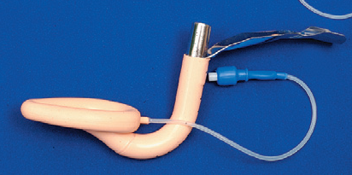
short, curved stainless steel shaft with a standard 15-mm connector.
Large enough to accommodate 8.0 mm tube
Short enough for the normal length tube to use .
The metal handle is securely bonded to the shaft near the connector end to facilitate one handed insertion, position adjustment, and maintain the device in a steady position during tracheal tube insertion and removal

Slide 5
the bowl of the device is rigid as is the short, wide right-angled (approximately 110°) airway tube, which is constructed of stainless steel.
Latex free
Sizes 3, 4 and 5
Stabilizer for removal of LMA

Slide 7
Technique
Head in neutral position – pillow but no extension
One hand insertion – handle and hand
The mask tip is positioned flat against the hard palate immediately posterior to the upper incisors and then slid back and forth over the palate to spread the lubricant.
After the mask is flattened against the hard palate, it is inserted with a rotational movement along the hard palate

Slide 8
Technique
Just open mouth slightly
Push the metal part up to the chin
Slightly rotate then --
Don’t lever the metal handle
After inflation , anterior adjustment for optimal ventilation

Slide 9
Primary device without tube
Easy to insert
More success
In obese patients – better
Out of hospital airway management – better
It is easier to place than the LMA-Classic when manual in-line stabilization is used

Slide 10
Tracheal tube made with a soft rounded silicone ‘bullet shaped’ tip to better negotiate the curve of the device and which is less traumatic when impacting the larynx.
The ILMA tracheal tubes range in size from 6.0 to 8.0 mm ID, with all size tubes passing through all ILMAs.

Slide 11
The tube
It’s a silicone, wire-reinforced, cuffed tube with a tapered patient end and a blunt tip
This tube is flexible, which allows it to negotiate around the anatomical curves in the airway.
It has a high-pressure, low-volume cuff that reduces resistance during intubation and makes cuff perforation less likely.

Slide 13
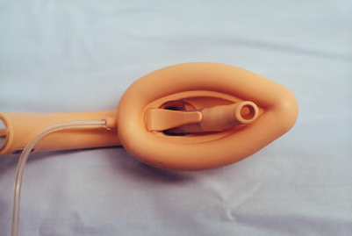
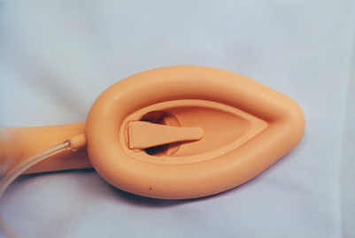
Fibrescope – more successful intubations
Flap instead of grille

Slide 14
Routine tube – more trauma
Warm the tube may be OK
No routine metal embedded tubes
Resistance before – take out 6 cm the LMA and reinsert
Rotate the tube - resistance 2 cm beyond
More than 3 cm – may be larger LMA is needed

Slide 15
Remove Connector – stabilizer- push – deflate the mask and remove
Do we need to remove the LMA ?
Slightly deflate and keep
These tracheal tubes – more than 1 hour ?

Slide 16
Pearls
more time for intubation
more esophageal intubations
More mucosal trauma than rigid laryngoscopy.
Same CVS response
Cant change head position
Unsuitable for MRI
increased incidence of sore throat, sore mouth, and difficulty swallowing than classic
Not for routine use ?? .

Slide 17
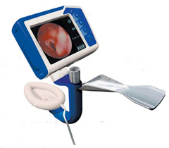
LMA c Trac – fibre optic system

Slide 18
Two channels, one to convey light from and the other to convey the image to the viewer.
This fibreoptic system is sealed and robust, and the CTrach can be autoclaved.
The Ctrach has an epiglottis elevating bar, which elevates the epiglottis during passage of the endotracheal tube (ETT) through the CTrach into the larynx.
This bar has an aperture through which the anatomy anterior to the bar is viewed.

Slide 19
Special ??
can be inserted exactly the same as the LMA Fastrac
once the airway is secured and patient is being ventilated, the viewer is switched on, placed in the magnetic connector and a clear image of the larynx is displayed in real time.
The ET tube can be viewed as it enters the trachea.
Once the patient is intubated, the viewer is removed and the mask is removed leaving the ET tube in place.
99 $ Vs 9990 $

Slide 20
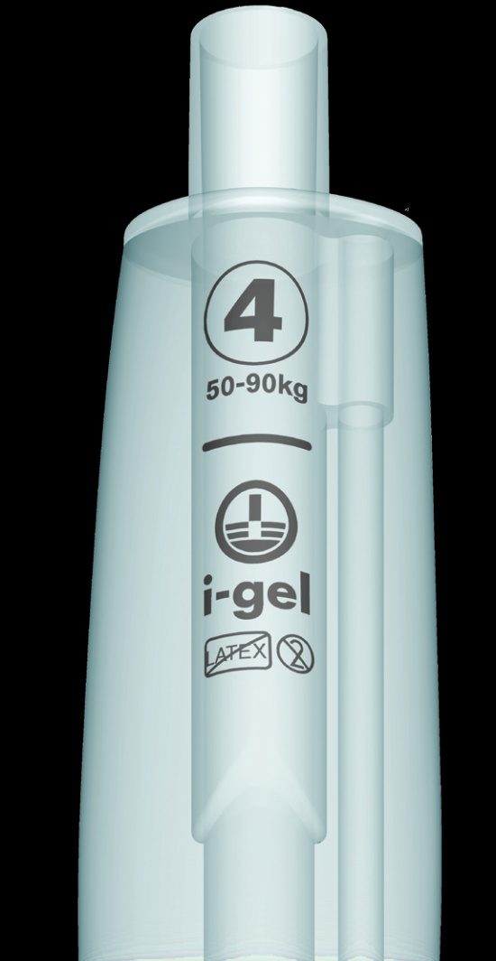
Connector – 15 mm
Bite block
Buccal stabilizer
Gastric
Epiglottic rest
Non inflatable cuff

Slide 21
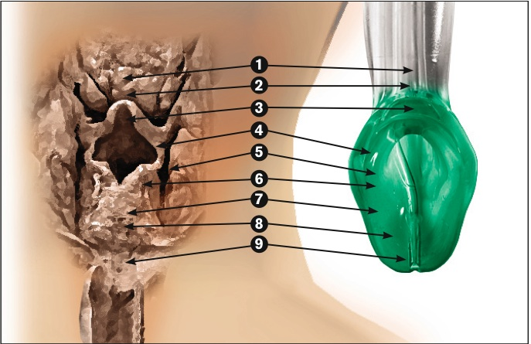
About igel
gel-like transparent thermoplastic elastomer. It does not contain latex.
It is designed to create an anatomical seal without an inflatable cuff.
Line to mark the position
Buccal cavity stabilizer

Slide 23
Pearls
improved ease of use,
improved ventilation
increased safety compared to the cLMA,
Disposable
Cases of airway rescue
facilitate fibreoptic-guided intubation
Smaller gastric access than pLMA
Lesser sealing pressures than pLMA

Slide 24
Technique
Disposable , Remove from cradle
Apply gel and swipe
Similar to c LMA , sniffing position, chin press
Cradle is not an introducer
The i-gel is inserted by grasping the bite block firmly and positioning the device so that the cuff outlet is facing toward the patient’s chin.
First and the second resistance
Rotational methods , jaw thrust, reverse - also described

Slide 25
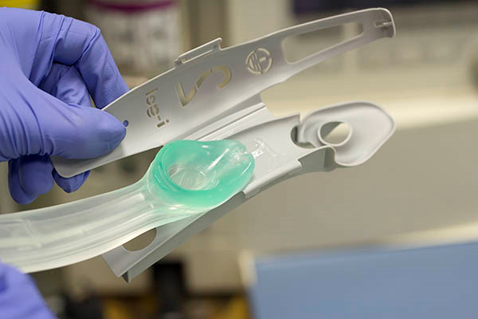
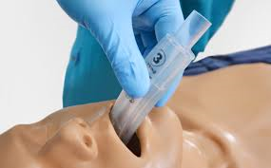
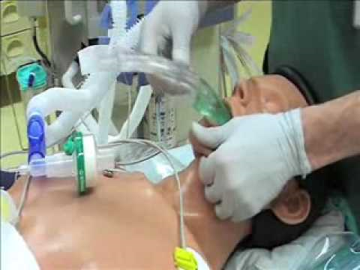
Igel insertion and position

Slide 26
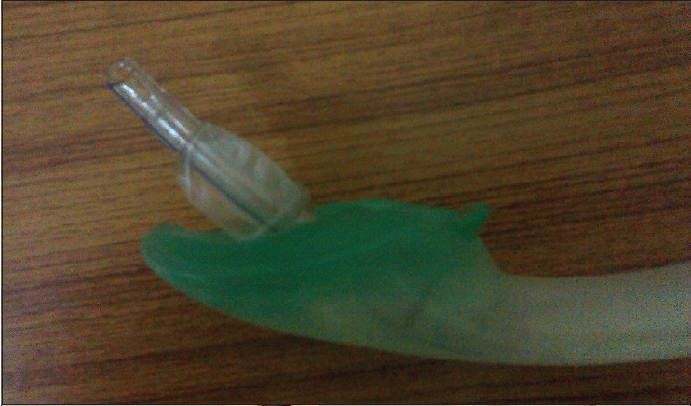
92 % success rate
Change the i-gel – 96 %
Contraindications- Similar to classis LMA
Four hours maximum

Slide 27
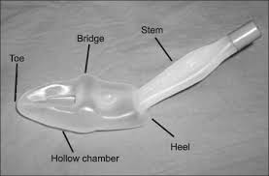
SLIPA
The Streamlined Liner of the Pharynx Airway is an inexpensive single use SAD of novel design, a blow-moulded airway made of a polyethylene based composite with the shape mimicking a ‘pressurized pharynx’
It forms a seal with the pharynx at the base of the tongue and the entrance to the esophagus by virtue of the resilience of its walls.
Diameter of bridge = thyroid cartilage = size of SLIPA

Slide 28
The distal part of the SLIPA is shaped like a hollow boot with a toe, bridge,and heel.
There is an anterior opening for ventilation.
The end of the toe rests in the esophageal entrance.
The bridge fits into the pyriform fossae at the base of the tongue, which it displaces from the posterior pharyngeal wall.
The heel connects to the airway tube, which is rectangular in shape and has a color-coded connector.
The heel serves to anchor the SLIPA in a stable position

Slide 29
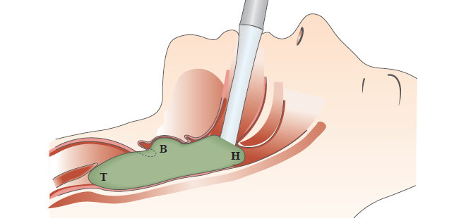
SLIPA

Slide 30
According to the manufacturer, the SLIPA usually does not need to be fixed in place.
The SLIPA has a large-capacity chamber for storing regurgitated liquids.
Toward the toe side of the lateral bulges of the bridge are smaller secondary lateral bulges. This feature is meant to relieve pressure at this site and prevent damage to the hypoglossal and recurrent laryngeal nerves.

Slide 31
The head is extended ,the device inserted toward the back of the mouth
the heel locates itself in the pharynx. jaw is lifted forward.
laryngoscope or gloved fingers can be used to have a space in the pharynx.
Airway seal pressure it is too low, a larger size SLIPA should be
If positive-pressure ventilation is used, the epigastrium should be auscultated - gastric inflation is not occurring.

Slide 32
If obstruction is encountered immediately after insertion, a downfolded epiglottis may be the cause.
The head should be extended and the jaw pulled forward. If this does not correct the problem, the SLIPA should be removed and reinserted with an accentuated jaw lift.
Another maneuver is to momentarily insert the SLIPA deeper so that it will free up the epiglottis.
If this does not relieve the obstruction, the likely cause is laryngospasm.

Slide 33
50 to 60 ml space for regurgitated liquids while it is 5- 10 ml for c LMA
Suspected regurgitation – slide suction by the sides
Controlled also ok
No cuff – no nitrous problem

Slide 34
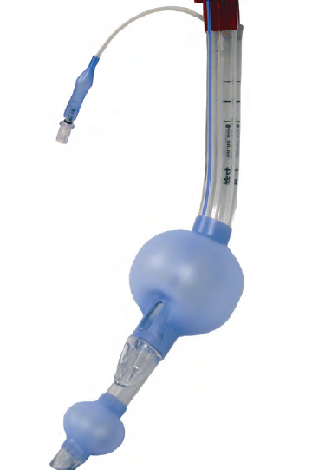
Laryngeal tube
Two cuffs
Blind distal end
Two openings between
Two cuffs but one
Inflation channel

Slide 35
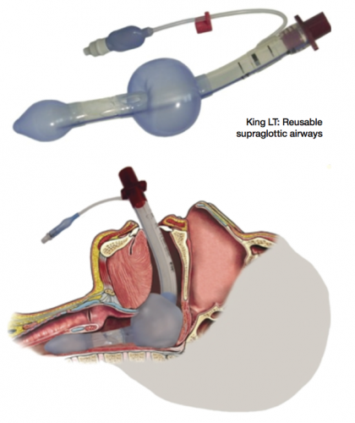

Slide 36
Laryngeal tube

Slide 37
Pearls
Insertion is simple
Autoclavable – 50 times
Fibrescope – insertion – can be done
But intubation better with fastrach
Positive pressure ventilation better with proseal
Aspiration safety – proseal is better
Hence lost popularity

Slide 38
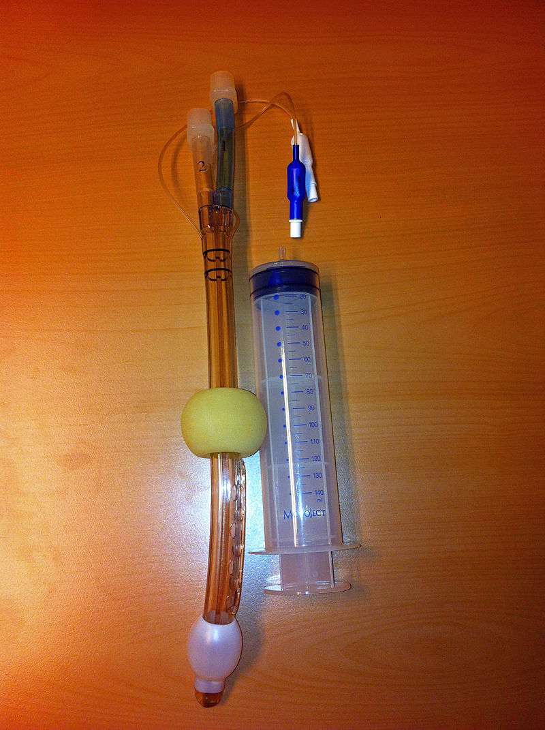
Two cuffs
Two channels
One opening between
One distal
Emergency airway

Slide 39
Cuffed oropharyngeal airway(COPA)
modified Guedel-type oral airway
with a cuff at its distal end, as a seal
Almost comparable with classic LMA

Slide 40
Cuffed oropharyngeal airway(COPA)
When the cuff is inflated, it displaces the base of the patient's tongue anteriorly and passively elevates the epiglottis away from the posterior pharyngeal wall.
The proximal end of the device has a standard 15-mm connector, an integrated bit block (tooth-lip guard), and two posts for attaching the elastic fixation strap.

Slide 41
The COPA is available in sizes 8, 9, 10, and 11, which refer to the distance in centimeters between the tooth-lip guard and the distal tip.
COPA is inserted easily and the anesthetic requirements for insertion are less than with the LMA device,
additional airway manipulations may be necessary during the intra operative period.

Slide 42
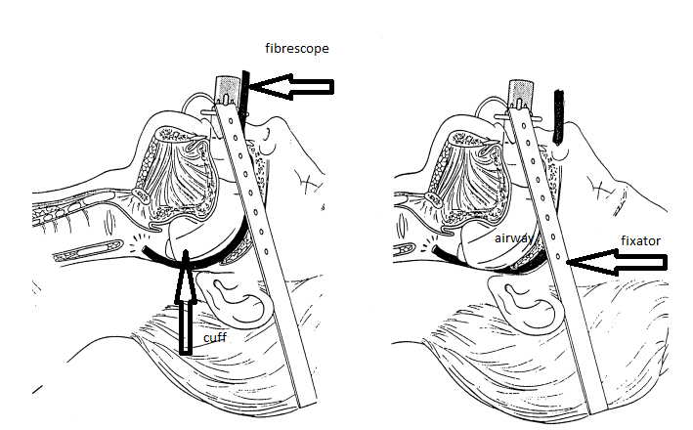
Fibrescope aided nasal and oral intubation

Slide 43
Summary
Fastrach
Ctrach
Igel
Slipa
Laryngeal tube
Combitube
COPA
Classification
With drainage or not
Perilaryngeal or peripharyngeal
Suffix I for intubation
Direct or guided
Cuffed perilaryngeal sealers – such as the Laryngeal Mask Airway®
Cuffed pharyngeal sealers – such as the Cuffed Oropharyngeal Airway (COPA®)
Uncuffed anatomically preshaped sealers – such as i-gel®

