Slide 1
Tracheostomy
Dr. S. Parthasarathy
MD., DA., DNB, MD (Acu),
Dip. Diab. DCA, Dip. Software statistics
PhD (physio)

Slide 2
Definition
The term tracheotomy refers to the formation of a surgical opening in the trachea.
Nomenclature ??
It refers to a temporary procedure.
Tracheostomy on the other hand refers to the creation of a permanent stoma between the trachea and the cervical skin

Slide 3
History
First described in Rig veda in 2000 BC
In the 1800s tracheostomy gained in popularity, as it became a recognised way of treating patients with Diphtheria.
High and low
Chevaliar Jackson 1909
mortality -- 25% to 1–2% by passage of a few decades

Slide 4
Indications
1. Mechanical obstruction of the upper airways.
2. Protection of tracheobronchial tree in patients at risk of aspiration.
3. Respiratory failure.
4. Retention of bronchial secretions.
5. Elective tracheostomy, e.g. during major head and neck surgery a tracheostomy
can provide/improve surgical access and facilitate ventilation.

Slide 5
Mechanical (1)
Congenital : Subglottic or upper tracheal stenosis, laryngeal web, laryngeal and vallecular cysts, tracheo-oesophageal anomalies or haemangioma of the larynx.
Infective Acute epiglottitis, laryngo tracheo bronchitis, diphtheria or Ludwig’s angina.
Malignancy Advanced tumours of larynx, tongue, pharynx or upper trachea presenting with stridor.
.

Slide 6
Mechanical (1)
Trauma
Gunshot and knife wounds to the neck, inhalation of steam or smoke, swallowing of corrosive fluid.
Vocal cord paralysis
Post-op complication of thyroidectomy, cardiac or
oesophageal surgery, bulbar palsy.
Foreign body Swallowed or inhaled object lodged in upper airway causing stridor

Slide 7
Neuro
Neurological diseases
GBS, Bulbar palsy,polio,MND
Coma
GCS < 8

Slide 8
RESPIRATORY FAILURE
Pulmonary diseases
(exacerbation of chronic bronchitis and emphysema, severe asthma, severe pneumonia).
Severe chest injury (flail chest).

Slide 9
RETENTION OF BRONCHIAL SECRETIONS
chronic pulmonary disease,
acute respiratory infection, decreased level of consciousness, and trauma to the thoracic cage or musculature with in-effective cough and retention of secretions

Slide 10
Described originally
But now ---

Slide 11
Recently
1. Prolonged or expected prolonged intubation
2. Inability of patient to manage secretions
3. Facilitation of ventilation support
4. Inability to intubate
5. Adjunct to manage head and neck surgery
6. Adjunct to manage significant head and neck trauma
FESTIVALS - pneumonic

Slide 12
Problems with physiology
warming, humidification and filtering of air do not take place before the inspired air reaches the trachea and lungs.
The normal mucociliary clearance mechanism is disrupted.
Cant talk
Cant swallow with ease
Weak cough reflex

Slide 13
Advantages
Safe and secure
Comfort for the patient
Less sedation needed
Suction easier
Pneumonias less
Resistance is less ( dead space decrease by 70 ml)

Slide 14
Preparation
Informed consent
Neck examination
Bleeding disorders
A good assistant
Procedure
Anaesthesia or not
Emergency or elective

Slide 15
Position

Slide 17
Procedure – low

Slide 19
Parts of a tracheostomy tube

Slide 20
Different curves !!

Slide 21
Size !!
The size of the tracheostomy tube usually refers to the inner diameter of the
inner cannula.
In other words, the inner diameter reflects the narrowest diameter of a particular tracheostomy tube.
two sizing systems for tracheostomies: the Jackson sizing system and the International Standards Organization (ISO) sizing system

Slide 22
Inner cannula
purpose of the inner cannula is to clear secretions through cleaning or replacement at regular intervals. The standard inner cannula is used most often in the hospital setting because it frequently provides a 15-mm
Adapter.

Slide 23
The Obturator
assist with the insertion of the tracheostomy tube.
Typically, it is necessary to remove the inner cannula in order for the obturator to fit within the outer cannula
Keep it in vision

Slide 24
neck flange
The purpose of the neck flange is to stabilize the tracheostomy tube, seating it against the neck and preventing it from migrating inward.
Labels

Slide 25
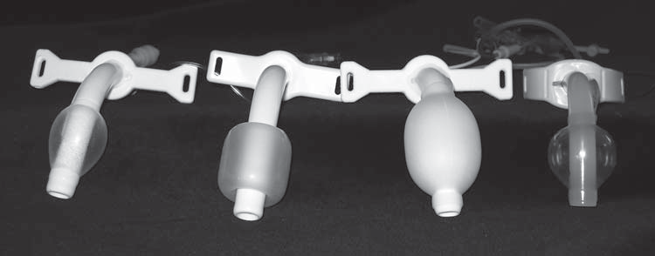
The Pilot Balloon and the Inflation Line
The Cuff( high pressure, barrel, foam, tear drop) Capillary perfusion pressure is considered to be between 20–30 cm H2O

Slide 26
Types – numerous
1) Single cannula --- cuffed and uncuffed
2) Double cannula --- cuffed and uncuffed
3)Unique a) fenestrated b) talking c) big size

Slide 27
Dual cannula cuffed and uncuffed

Slide 28
Single cannula cuffed and uncuffed

Slide 29
Talking --------- fixed flange

Slide 31
Talking

Slide 32
Talking valves

Slide 33
Flange adj. -- --- Armoured

Slide 34
Extra long ------- suction ports

Slide 35
Metal fenestrated

Slide 36
Original - Colour coding of tubes
Orange 6
Green 7
White 8
Blue 9
Yellow 10

Slide 37
Percutaneous dilatational tracheostomy (PDT)

Slide 38
percutaneous dilatational tracheostomy (PDT) is defined as the placement of a tracheostomy tube with the help of one commercially available set using a series of dilators.
The most commonly used PDT kits are available from Cook Critical Care and Sims Portex, which include the single tapered tracheal dilator (Blue Rhino) developed by Ciaglia.
without direct visualization of the trachea.

Slide 39
The pre requisites
PDT necessitates the administration of adequate pain relief, sedation and neuromuscular blockade to the already intubated and mechanically ventilated patient.
Due to this a PDT cannot be used for emergency airway management as in supraglottis or oro facial trauma.
Otherwise indications are similar

Slide 40
Questions about PDT
Patients under the age of 16 years
Obvious deformities of the airway, previous scars from surgeries like a tracheostomy sternotomy, neck oedema, gross obesity, a mass (for example a goitre) or a tumour in the neck make it difficult to easily palpate the local landmarks like the cricoid cartilage.

Slide 41
Inability to optimally extend the patient’s neck due to cervical spine trauma or arthritis, the presence of a short neck or due to severe kyphosis.
Haemo dynamically unstable and difficult airways ??

Slide 42
Advantages
Monitors and lines
Time 30 Vs 60 minutes
Cost and theatre personnel
Less trauma– less bleeding and less infection
Decannulation is easier
Scar is less
In MTS, direct cost is less

Slide 43
Nasogastric feed is stopped at least 2 h before the planned time of PDT and the stomach contents emptied just before the actual procedure to prevent aspiration into the airway.
Position similar
100% oxygen; adequate analgesia,
sedation and muscle relaxation are also ensured

Slide 44
Ventilator settings adjusted for leaks
PEEP 10 – 15 cm
All monitors and IVF and drugs
Bronchoscope introduced
ET tube withdrawn and cuff deflation adequate

Slide 45
The ultimate tube placement is made at the level of the first and the second tracheal cartilages or between the second and the third tracheal cartilages whenever possible.
A 2–3 mm midline subcricoid transverse incision is made on the skin at the pre-selected site.

Slide 51
Start dilating with a set of 7

Slide 52
4, 6, 8 ---- 24, 28, 32

Slide 54
Care of the tracheotomy
Extra tracheostomy tube of same size
■ Extra tracheostomy tube one size smaller
■ Obturator
■ Suction catheters
■ Manual resuscitation bag
■ Suction source, tubing
■ Oxygen source
■ Comparably sized endotracheal tube
■ Tracheostomy dressings (drain sponges)
■ Tracheostomy tube holders (or twill tape)
■ Tracheostomy cleaning kits

Slide 55
Care of the tracheotomy
Security – flange suturing
Seven days for the transition from an
immature to a mature tracheostomy.
Mature stoma better in case of accidental decanulation

Slide 56
Inner cannula
Recommended 2 – 3 times a day
The inner cannula should be placed in the container of hydrogen peroxide solution and allowed to soak for 3–5 minutes in order to soften and dissolve the accumulated secretions. - water -- dry
During this interval, the stoma can be cleaned with cotton swabs dipped in saline.

Slide 57
Cleaning Metal Tracheostomy Tubes
place the tube in a pan of tap water and boil for 30 minutes, followed by wiping dry the cooled tube.
Bivona and Arcadia lines of tracheostomy tubes (made of silicone) should be cleaned with a mild detergent.

Slide 58
Changing the Tracheostomy Tube
The entire tracheostomy tube should be changed on a regular basis in order to prevent infection, obstruction of the tube, and other complications associated with an indwelling airway device
Two weeks – two months
First change ???

Slide 59
Care of the Stoma
3% hydrogen peroxide is often used to clean around the stoma and soften encrustations.
It can be applied full or half strength to a cotton swab to cleanse the skin around the tracheostomy tube, underneath the neck flange along the entire circumference of the stoma, and particularly along the point of connection with the neck flange.

Slide 60
Secretions
Goblet cells – upto 100 ml/day
Cough if present ok – but in these patients ??
When needed than routine – lot of studies but one tells
suctioning frequency of every 8 hours in order to reduce the accumulation of secretions and airway occlusion

Slide 61
suctioning
clinical signs that indicate suctioning—visible
secretions, audible gurgling, coarse or diminished breath sounds, dyspnea, increased airway pressures, and unexplained desaturation
complications may result from the suctioning procedure, including cardiac arrhythmias, hypoxemia, atelectasis, bleeding, and infection

Slide 62
Odel s formula for catheter size
(Size of endotracheal tube or tracheostomy tube – 2) × 2
= size of French catheter
According to this formula, a patient with a size 8 tracheostomy tube should be suctioned with no greater than a 12 French suction catheter.

Slide 63
How to apply suction
when suction is applied, secretions as well as oxygen are removed from the tracheo bronchial tree.
Desaturation– arrhythmias
suction be applied for less than 12 seconds, only upon withdrawal of the catheter, and with a suction pressure of less than –80 to –120 mm Hg
Is it effective ??

Slide 64
Hyperoxygenation and hyperinflation
Hyperoxygenation is the delivery of oxygen at a greater concentration than the patient is already receiving, up to 100% concentration.
use of 150% of the preset tidal volume for at least three breaths.

Slide 65
Depth of suctioning
introducing the suction catheter to the level of the carina, and then withdrawing 1–2 cm before applying suction.
Deep or shallow
Mild bleeding OK

Slide 66
Suction – continued
Closed or open suction systems
The instillation of 2–10 ml of normal saline, followed by manual ventilation with a resuscitation bag, has been used for loosening and thinning secretions just prior to aggressive suctioning.
??? Use

Slide 67
Humidification
Humidification can be provided by a tracheostomy collar, an HME, or atomized saline.
HME for around 5 days
Physical movement of any kind helps mobilize secretions. Active or passive range-of-motion exercises for bedridden patients can be effective in mobilizing secretions, strengthening respiratory muscles, and improving cough ability.

Slide 68
Oral Care
Increased VAP.
Recommended oral care includes tooth brushing ( 12 hours ), chlorhexidine oral swabbing, and deep subglottic suctioning above the cuff.( continuous)
Nutrition – enteral feeds !!

Slide 69
Home emergencies
1. Remove inner cannula (clean if obstructed).
2. Suction deeply.
3. Use manual resuscitation bag to provide rescue breaths.
4. Change entire tracheostomy tube. (If tube is still obstructed and stoma is mature, remove tube and suction directly into stoma.)
5. Provide Heimlich maneuver

Slide 70
Intra operative Complications
Bleeding
Pneumothorax
Difficult cannulation
Airway fires
Air Embolism

Slide 71
Early Postoperative Complications
Tracheostomy Tube Displacement and Loss of Airway
Tube Obstruction
Postobstructive Pulmonary Edema
Pneumomediastinum

Slide 72
Late Postoperative Complications
Tracheo innominate Fistula/Hemorrhage
Tracheo esophageal Fistula
Tracheo cutaneous Fistula
Tracheal stenosis
Tracheomalacia

Slide 73
If we want to detail the complications

Slide 75
Pistoning

Slide 76
Decannulation
Decannulation should be considered
when the reason for tracheostomy placement is resolved,
when airway secretions have abated,
when mechanical ventilation is no longer required

Slide 77
cannulation times
12 days
25 days
3.5 years
The most important factor when considering decannulation is the initial reason for tracheostomy placement.

Slide 78
VOPS
safe to consider downsizing and de cannulation as soon as the patient has been liberated from continuous positive-pressure ventilation for at least 24 hours.
Obstruction. Depending on the nature of the obstruction, the tracheostomy tube can be decannulated after the obstruction is relieved

Slide 79
Protection. The two primary mechanisms that contribute to airway protection are an
Adequate cough and an adequate swallow
Secretions. The failure of patients to manage secretions is a common reason for the continued placement of a tracheostomy tube

Slide 80
Fenestrations for trial breathing

Slide 81
Decannulation
Decannulation is the deliberate and permanent removal of the tracheostomy tube.
Remove cuff-
30 minutes , block 24 hours – decannulate
12 – 24 hours – decannulate 48 hours later
Capping
Bronchoscopy

Slide 82
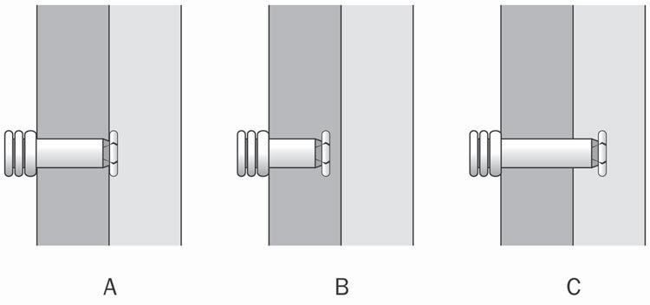
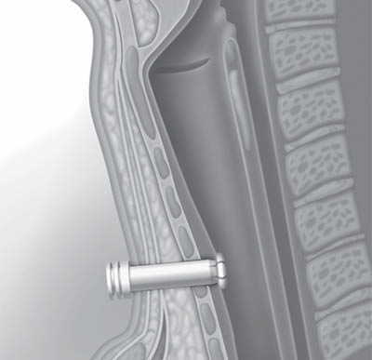

Slide 83
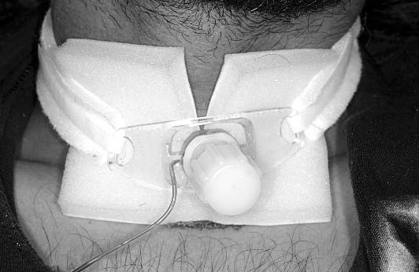
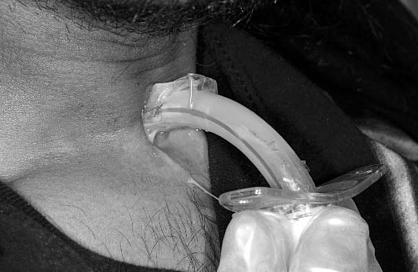

Slide 84
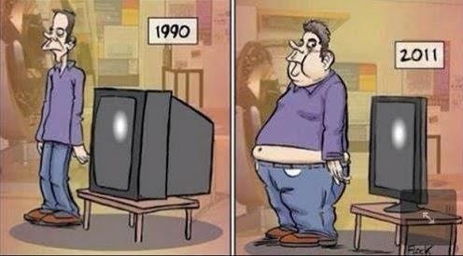
Too big
Thank you all

