Slide 1
Post burns contracture neck anesthetic considerations
Dr. S. Parthasarathy
MD., DA., DNB, MD (Acu),
Dip. Diab.DCA, Dip. Software statistics
PhD (physio)
Mahatma Gandhi medical college and research institute , puducherry – India

Slide 2
Introduction
PBSC of the neck causes functional limitations and aesthetic disfigurements
There should be some surgical treatment
Principles
releasing the shrunken area,
restoring the contour of the mento-collical angle,
preventing recurrence.

Slide 3
Principles

Slide 4
Challenge
Performing the surgical procedure demands maintenance of the airway for a prolonged procedure by OT intubation, which is impossible to accomplish because of the chin's adherence
to the jugulum

Slide 5
Phase
Reconstruction and not resuscitation

Slide 6
Preoperative
Many procedures – good rapport
Should talk
History
Electrical , chemical , inhalational

Slide 7
Preoperative
Airway and plan
patient does not snore or experience sleep apnea, it is likely that his/her airway will remain patent during anesthesia. mask – ok
as long as the patient’s interincisor distance was >18 mm, the LMA could be successfully inserted to provide a patent airway and maintain adequate ventilation.

Slide 8
IV access
All others
Blood reservation
Previous anaesthesia – yes and no

Slide 9
Investigations
Hb,
Blood urea, sugar electrolytes
LFT and full RFT if needed
ECG
Blood grouping
CxR,
Clotting profile

Slide 10
Premedication
Premed – antisialogogues and sedatives
The property of antirecall with lorazepam is very beneficial as these patients undergo multiple procedures.
Narcotic – ok
Blood availability

Slide 11
Fitness given can change in the next three months

Slide 12
Intravenous access
a. Establishing vascular access is extremely important prior to burn excision and grafting procedures.
b. In most cases, a minimum of two large-bore peripheral intravenous lines or one peripheral and one central line are necessary.
c. It is often difficult to place intravenous lines in these patients due to the extent of the burn.
Femoral – USG guided

Slide 13
What is special ??
Analgesia
Surgeon ready
Preoxygenation
Induction and airway plan

Slide 14
Monitoring
Pulse oximeter probe ??
ECG electrodes pasted ??
BP cuff ??
Temporary tarsoraphy
Catheterize or not ??

Slide 15
Airway problems
causes of difficult endotracheal intubation fall into four main categories:
limited oropharyngeal space,
decreased pharyngeal space
decreased atlanto occipital extension
decreased submandibular compliance

Slide 16
How to go about ??
The routes available for airway control are subdivided into routes above the cords, (nasal and oral),
and routes below the cords; cricothyrotomy and tracheostomy.

Slide 17
Routes above the cords,
Oral and nasal intubation (Visualized or blind)
LMA
I gel
Combitube
FOL
FOSL
Airways

Slide 18
Induction
Awake
Inhalational
Intravenous
Scoline ???

Slide 19
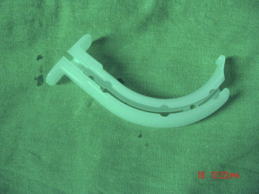
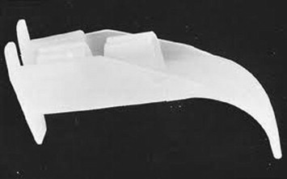
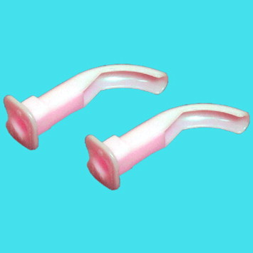
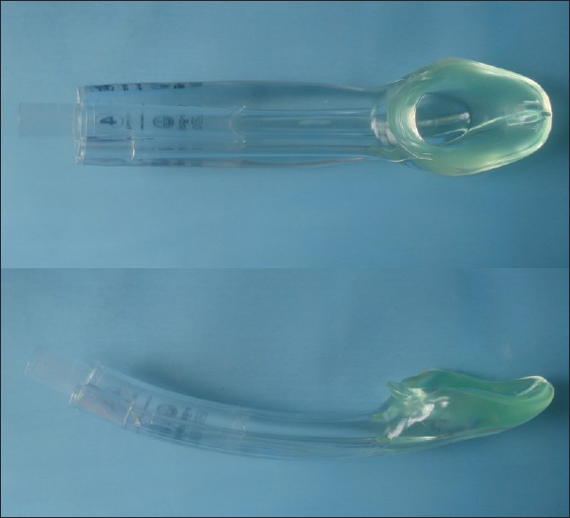
Airways

Slide 20
fiberoptic stylet laryngoscope

Slide 22
Blue -operator ---- yellow -assistant

Slide 23
I gel
The i-gel is cheap, effective airway device which is easier to insert and has better clinical performance in the difficult airway management of the airway in the post burn contracture of the neck
2012 Jul - Singh J, Yadav MK, Marahatta SB, Shrestha BL - Indian journal of anaesthesia

Slide 24
Trachlight and awake intubation
A combination of Trachlight and atomizer can also provide excellent topical anaesthesia of the airway for awake orotracheal intubation. This technique is easy to perform, well tolerated by the awake patient, and useful in difficult intubation
but transillumination can be the problem in patients having dense fibrous band

Slide 25
Conduct – nothing special
Agent with air / nitrous described
technique ideal - Desflurane in air – described by a few
NMJ, temperature and blood loss are special in monitoring

Slide 26
extubation
a preformulated strategy for extubation of the difficult airway.
The extubation strategy of the difficult airway
type of surgery,
the medical condition of the patient,
experience and preference of the anesthesiologist.
The airway exchange catheter (AEC)

Slide 27
Special post op
Cough
Restlessness NO
Shivering
Analgesia – LA to the SSG area
narcotics , NSAIDs
Calm smooth recovery

Slide 28
TIVA
TIVA was likely to precipitate sudden loss of the airway control and the CICV situation.
In addition, all laryngospasm in a study also occurred in the patients using the TIVA. This may be due to the increased laryngeal sensitivity caused by thiopentone.
Chinese Medical Journal 2008; 121(11):989-997

Slide 29
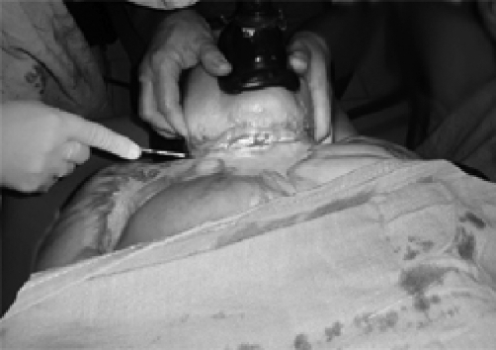
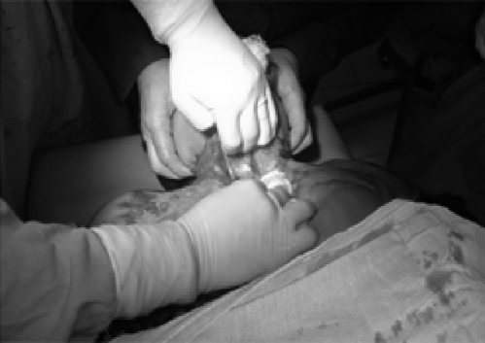
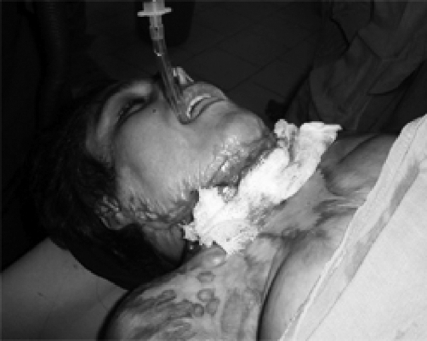
IV ketamine

Slide 30
Tumescent local anesthesia

Slide 31
Preparation
It is prepared by
mixing 30 cc of 2% lidocaine,
20 cc of sodium bicarbonate,
one ampoule of epinephrine and
one ampoule of Hyalase
450 cc of Ringer lactate solution

Slide 32
Tumescent local anesthesia
Skin incision was marked
tumescent local anesthesia infiltrated along with the incision line and in to the surrounding areas.
Volume of ranged from 70 ml to 200 ml.
0.4% lidocaine, 1:500,000 epinephrine with sodium bicarbonate and Inj. Hylase.

Slide 33
Tumescent local anesthesia
A safe upper limit for lidocaine dosage using the tumescent technique is estimated to be 35 mg/kg.
Infiltrating a large volume of dilute epinephrine assures diffusion throughout the entire targeted area while avoiding tachycardia and hypertension.
The associated vasoconstriction was so complete that there was virtually no blood loss in surgery

Slide 34
Tumescent local anesthesia
Injection pain could be reduced by buffering the solution using sodium bicarbonate in a dose of 1 mEq per 10 ml of lidocaine ratio to make solution more physiologic in pH.

Slide 35
Pros and cons
No need for endo-tracheal intubation
Less blood loss
Space for dissection
Patient is conscious
Anaesthesia adequate
Effective Post op analgesia
Only disadvantage of tumescent local anesthesia is a wet surgical field.

Slide 36
Summary
History – type of burns , prev.anesthesia
Airway and IV access
Induction and maintanance
Extubation
Tumuscent local anaesthesia

Slide 37
Thank you all

