Slide 1
PAIN FACTS - 4 Complex regional pain syndrome (CRPS)
Dr. S. Parthasarathy
MD., DA., DNB, MD (Acu), Dip. Diab. DCA, Dip. Software statistics PhD (physio)
Mahatma Gandhi medical college and research institute , puducherry – India

Slide 2
Definition
Complex regional pain syndrome represents an abnormal response to injury, usually of an extremity, presenting as prolonged, often intense pain, vasomotor disturbances, delayed functional recovery and trophic changes

Slide 3
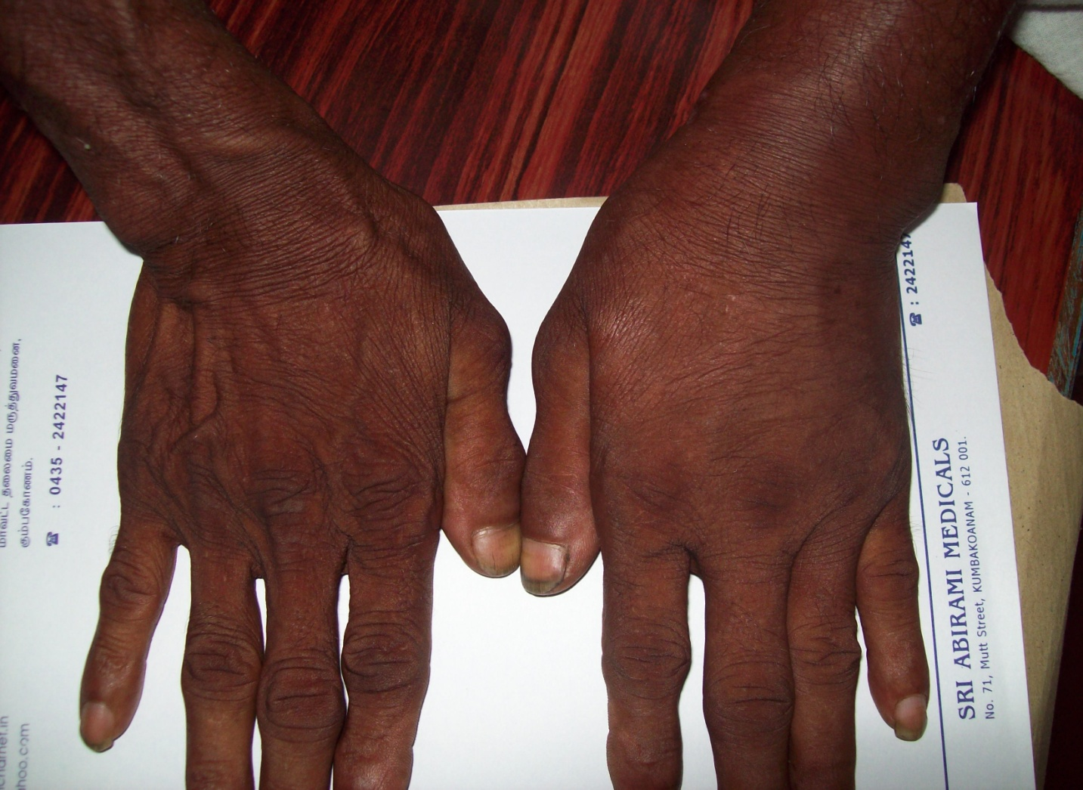
CRPS

Slide 4
Synonyms
Causalgia,
Sudeck’s atrophy,
post-traumatic dystrophy,
shoulder hand syndrome,
algodystrophy,
algoneurodystrophy,
reflex neurovascular dystrophy
reflex sympathetic dystrophy

Slide 5
IASP
International Association for the Study of Pain (IASP) introduced a single term
Complex Regional Pain Syndrome
(CRPS, 1994), to accommodate the differing clinical presentations
syndrome may follow as many as 5% of all traumatic injuries.

Slide 6
Types
Type 1
is not associated with a specific nerve injury and does not follow an anatomical distribution of a peripheral nerve,
Type II, has similar symptoms and signs to those in Type I,
is associated with an identifiable nerve injury

Slide 7
Three classical stages
Acute:
up to 3 months from the onset. The limb is warm, the skin red, with swelling with palmar or plantar hyperhydrosis, hyperesthaesia and joint stiffness.
No effusion or fixed contractures.

Slide 8
The other two stages
2)Dystrophic: 3–6 months after the injury. The limb is cool, cyanotic and indurated. Hyperaesthesia is present, fixed contractures begin to occur, with ankylotic changes in the small, distal joints of the limb.
3) Atrophic: after 6 months. The skin may become hairless and loses its folds. Contractures prevail
changes become permanent.

Slide 9
CRPS is not a non corrupt Govt. official
It can jump to stage 2 or
it can skip stage 2

Slide 10
Symptomatology
Mild
Moderate
Severe
Or

Slide 11
Symptom type
Autonomic : sweating, swelling, warm or cold
Motor : muscle weakness, tremor
Sensory : pain deep, spontaneous orthostatic, nocturnal
Trophic changes : glossy skin, hair nail disturbances osteoporosis

Slide 12
Special about symptoms
Upper Vs lower limb 2 :1
CRPS possible in knee, shoulder, hip etc
Both sides
Rarely all four limbs affected
Peak 50 years age
Female more
Preceding trauma

Slide 13
Mechanism of CRPS
Every one gets injured
Why some develop CRPS ??

Slide 14
Prone for CRPS !!
1. Genetic
2. disuse
3.psychogenic

Slide 15
Mechanisms
increase in the activity of the sympathetic nervous system in response to a noxious stimulus
Pain stimulates sympathetic
But sympathetic stimulates pain ??

Slide 16
Other mechanisms
Formation of abnormal synapses between sympathetic and sensory fibres.
A direct nerve injury resulting in an abnormal electrical discharge.
disruption of the auto regulation of blood flow
An increase in substance P.
plastic changes in the peripheral and central nervous system.
As a manifestation of a psychosomatic disease.

Slide 17
Diagnosis
Clinical
Sympathetic blockade
Sure it has done the job
Sure that it has not done extra
SIP

Slide 18
Phentolamine infusion test
Mixed alpha antagonist
Principle : norepinephrine released by nociceptors is blocked
Similar results of pain relief as stellate ganglion blockade
Simple , repetition possible

Slide 19
How to do it ??
Routine monitors, informed consent , RL , baseline pain score ,temperature
Propranolol 1-2 mg IV
Phentolamine 1 mg / kg over 10 minutes
VAS, temperature ,
BP pulse rate

Slide 20
IVRA with sympatholytics
Guanethidine
Taken up by NA varicosities
Depletes NA from sympathetic axons
prevents further release for1-2 days
Availability ??

Slide 21
Others
Skin blood flow measurements
Ischemia test
Xray and bone scan

Slide 22
Treatment of CRPS
SMP or not
----
Blocks
stellate , lumbar sympathetic , IVRA – guanethidine , phentolamine

Slide 23
Drugs
Antidepressants
Anticonvulsants
Alpha2 agonists
Alpha blockers
Opioids
Steroids , NSAIDs
Topical

Slide 24
Treatment and pathophysiology
SENSORY
EPIDURAL,BLOCKS
AUTO INFLM.
NSAIDs, STEROIDS
SYMP;
CRPS
STELLATE, IVRA
MOTOR
PSYCHO
PHYSIO
ANTIPSYCHIATRI

Slide 25
Article to be published in IJCP
1.Dr. S.Parthasarathy
2.Dr. M.Ravishankar
Electroacupuncture in Complex regional pain syndrome (CRPS) – a case report from the periphery.

Slide 26
What happens in acupuncture ?

Slide 29
Why it happens and in what belief

Slide 31
Summary
Definition
Types
Stages
Symptoms
Mechanisms
Diagnosis
Treatment

Slide 32
Thank you all

