Slide 1
DELIBERATE HYPOTENSION
Dr. S. Parthasarathy
MD., DA., DNB, MD (Acu), Dip. Diab. DCA, Dip. Software statistics, PhD(physiology)
Mahatma gandhi medical college and research institute, puducherry, India

Slide 2
DEFINITION
Reduction of the systolic blood pressure to 80-90mmHg
Reduction of mean arterial pressure (MAP) to 50-65 mmHg
30% reduction of baseline MAP
DRUG. 2007; 67 (7): 1053-76

Slide 3
Indications
Expected major blood loss
scoliosis,
revision hip surgery,
pelvic malignancies,
major vessel surgery,
reconstructive spinal surgery

Slide 4
Indications
Complex neuro surgery
Intracranial , spinal meningioma,
AV malformations
Pituitary surgeries

Slide 5
Indications
Microsurgery
Plastic,
Middle ear,
FESS
Vessel grafts

Slide 6
Indications
Intra ocular surgery
Choroid
Vitrectomy
INDICATIONS may reduce blood loss or provide a bloodless field

Slide 7
SPINE
S = SPINAL
P = PITUITARY, PELVIC, PLASTIC
I = INTRACRANIAL, INTRAOCULAR
N =NEURO, NEUROVASCULAR
E = EAR, ENDOSCOPIC SINUS

Slide 8
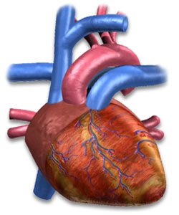
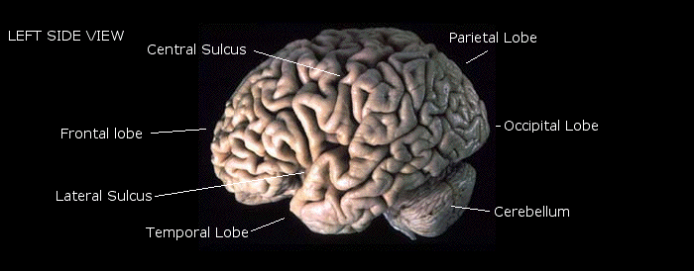
Get idea !! Blood flow to site stopped with preserved blood flow to vitals

Slide 9
Contraindications
Ischemic stroke
SAH,
Untreated hypertension
PVD,
Renal, liver impairment
IHD, fixed Cardiac output states
Hypovolumia,
Pregnancy, glaucoma

Slide 10
Essence to know -- MAP
Vasodilators
MAP = cardiac output ˟ TPR
cardiac output = heart rate ˟ strᴏke volume
Beta blockers Decrease preload and depress contractility

Slide 11
Techniques which reduce blood loss but not deliberate hypotension
Local with adrenaline
Tourniquet
IPPV
PEEP
Position
Spinal & Epidural

Slide 12
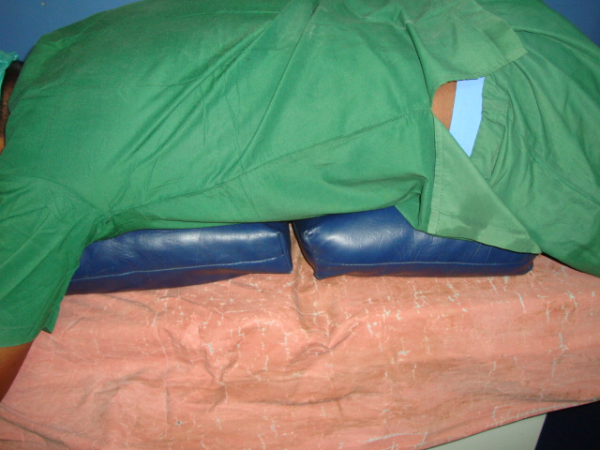
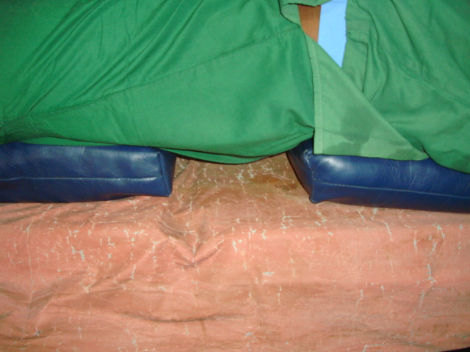
Position and bloodless fields
BP APP.

Slide 13
Technique
Suitable patient
↓↓ BP OK
Position
↓↓ BP OK
Isoflurane slowly withdraw each
↓↓ BP OK ↑↑
First line hypotensives → 2nd line hypotensives
BP OK

Slide 14
Technique
Keep MAP at 55 to 60 mm Hg
WHY ?
Auto regulation of Coronary and cerebral blood flow stops at MAP at 50 to 55 mm Hg

Slide 15
AGENTS
1. Neurological depressants
volatile anaesthetics , IV anaesthetics.
2. Vasodilators
Direct : SNP, NTG, Adenosine, PGE1, Hydralazine
Indirect : Trimethaphan(Intravenous infusion, 3 to 4 mg per minute)
3.Cardiac depressants : GA inh. Agents, β blockers, CCBs

Slide 16
By simple method
Decrease systolic to preop diastolic to a maximum
i.e
Preop BP : 130/85 mmHg
Come down systolic upto 85 intra op

Slide 17
Inh. agents
Isoflurane is ideal
2 MAC
SVR decrease without myocardial depression
Inh. of baroreceptor reflexes thro anaesthetic action
Halo OK but think of brady and myocardial depression

Slide 18
Enflurane – potent myocardial depression and possible ill effects on splanchnic perfusion
No to hypotensive use
Inh agents – think if cranium is not opened as they may raise ICT

Slide 19
SNP
Onset 30 sec, peak 2 min.
1 to 1.5 mic /Kg /min
Toxicity due to cyanide as metabolite – common after 8 mic /Kg /min
Systemic and pulmonary vasodilation
Young patients tolerant – baroreceptors and caatecholamines
Elderly be careful.

Slide 20
NTG
More effect on capacitance vessels
Better in IHD patients
Action a little delayed : 2 -10 min.
Reflex tachycardia

Slide 21
Adenosine
May have effect on his bundle and produce conduction disturbances
Adenosine 0.14 mg/kg/min
Ideal to give in central vein.
Hydralazine
Gradual and prolonged action

Slide 22
Beta blockers
Labetolol --both alpha and beta
time to recovery ??
Labetolol -4 hours Vs Esmolol - 9.2 minutes

Slide 23
Others
CCBs
Nicardipine
The infusion dose was 1.14 ± 0.45 µg·kg·min
PGE1- doses < 0.01 mcg/kg/min
Used in Japan for neurosurgeries successfully

Slide 24
Monitoring
Routine monitoring, ECG, EEG, ETCO2 + urine output
USE IBP
If persistent use rapid acting drugs are planned
Or
if systolic is = or << 70 mmHg

Slide 25
Combination
Position + iso + Esmolol or NTG
Local adrenaline + iso
Trimethaphan + NTG
Beta blockers + NTG

Slide 26
Some tips
Oral propranolol 40 mg tds followed by hypotensive anaesthesia
Oral ACE inhibitors followed by hypotensive anaesthesia
Why ??

Slide 27
DELIBERATE HYPOTENSION
Activates
Catecholamines
(oral propanolol)
Rennin angiotensin mechanism
(oral captopril)

Slide 28
Complications
Inadequate
Dosage, tolerance
Excessive
Maintain IV volume status ,
ECG,
dosage

Slide 29
Complications
Cerebral thrombosis 0.1 – 0.2 %
Coronary artery thrombosis 0.3 – 0.7 %
Renal failure 0 – 0.2 %
Hepatic failure, Postop pulmonary dysfunction, (Increased V/Q mismatch )
Rebound hypertension, Increased bleeding at operative site, Dimness of vision

Slide 30
Meta analyses of hypotensive anaesthesia
Improved surgical field and significant reduction in operation time
no significant changes in cerebral, cardiovascular, renal and hepatic functions in patients receiving hypotensive anaesthesia

Slide 31
Recovery
Vasodilators off
Then Inh. Agents off
Rebound hypertension can occur
Remember to correct hypothermia and pain before recovery

Slide 32
DELIBERATE HYPOTENSION: NEW TECHNIQUES
Use the natural hypotensive effects of anaesthetic drugs with regard to the definition of the ideal hypotensive agent.

Slide 33
Remifentanil- 1 µg.kg^{-1.}min^{-1 &}
0.05-2 µg.kg⁻¹.min⁻¹
Propofol 2.5 mg.kg⁻¹
& 200 µg.kg⁻¹.min⁻¹
Sevoflurane 2-2.5 %
Clonidine IV sos

Slide 34
Better than hemodilution techniques
hypotensive anaesthesia significantly reduces blood loss and transfusion requirements and minimizes allogenic transfusions risks. Induced hypotensive anaesthesia combined with isovolaemic haemodilution has no additional blood-sparing effects but impairs surgical field quality.
J Oral Maxillofac Surg. 2010 Dec;39(12):1168-74.

Slide 35
How to give controlled hypotension
the answer is VIAGRA
V – Vasodilators (SNP, NTG, Adenosine)
I - Inh. Agents , IV anaesthetics
A - Adrenergic blockers(labetolol,esmolol)
G – Ganglion blockers
R – Regional
A – Anaesthesia

Slide 36
TO CONCLUDE
Deliberate hypotension is for the
COMFORT OF SURGEON
Plan and do it with
the number 1 priority as
safety of the patient

Slide 37
Thank you all

