Slide 1
Blood substitutes
Dr. S. Parthasarathy
MD., DA., DNB, MD (Acu), Dip. Diab. DCA, Dip. Software statistics
PhD (physio)
Mahatma Gandhi Medical college and research institute , puducherry India

Slide 2
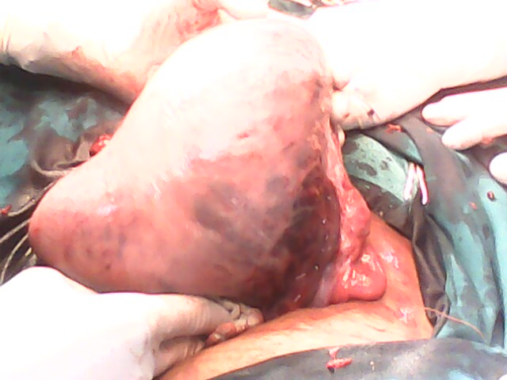
Why do we need blood substitutes?
.Blood shortages & donor recruitment
•Compatibility –need for cross-matching
•Cost of blood processing
•Shelf-life & storage
•Human error
•Unnecessary transfusions
•Risk of disease transmission
•Cultural & religious objection

Slide 3
Problems A,B,C,D,E,F
A dvances in surgery , adverse reactions
B lood shortage,
C ost, compatability ,culture
D onor, diseases,
E rror
F ridge

Slide 4
What are blood substitutes ??
Blood substitutes are fluids which when injected into the human blood stream contribute significantly to the transport of oxygen around the body
IV fluids which supply oxygen

Slide 5
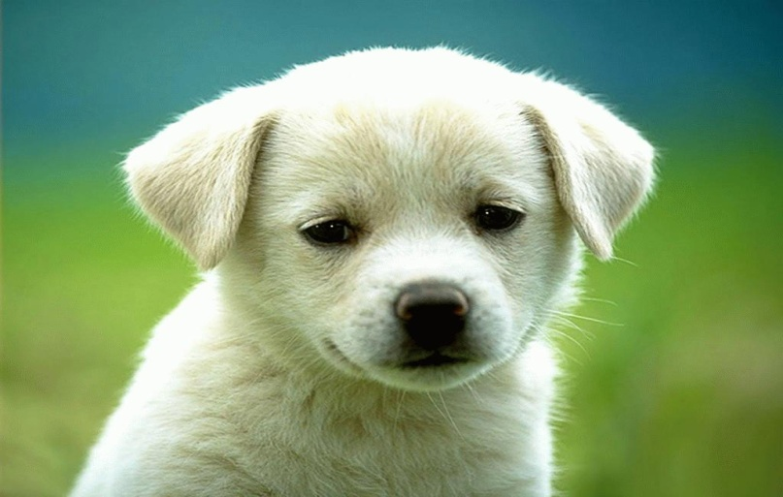
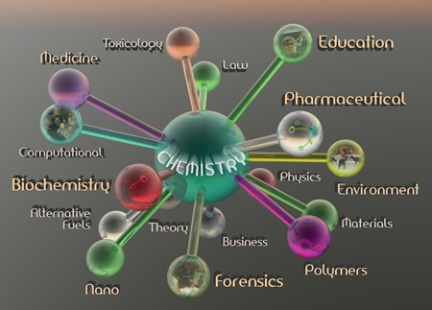
Types
Biotic
Hb based
Abiotic
PFC s

Slide 6
Haemoglobin based solutions
HemAssist (Baxter) –stabilized hemoglobin tetramer by diaspirin linkage
Somatogen (Optro, Baxter) –recombinant human hemoglobin
PolyHeme (Northfield) –glutaraldehyde polymerized human hemoglobin;
Hemopur-= (Biopure) – glutaraldehyde polymerized bovine Hb.
And a lot more

Slide 7
Pros of Hb solutions
No pro-inflammatory substances
Cheap; uses discarded blood- sometimes cow
Pure, virus-free Hb
No antigen testing.
Easy availability.
Jehovah witness – ok
low viscosity, high oncoticpressure

Slide 8
No 2, 3 DPG- shift –pyridoxlation or adding Cl⁻ corrects

Slide 9
Chemistry of HB solutions

Slide 10
No to Hb solutions – why?
Possible local vasoconstriction
Coronary and cerebral vascular supply compromise
Acute renal failure concerns
Systemic and pulmonary hypertension
Many are put to disuse

Slide 11
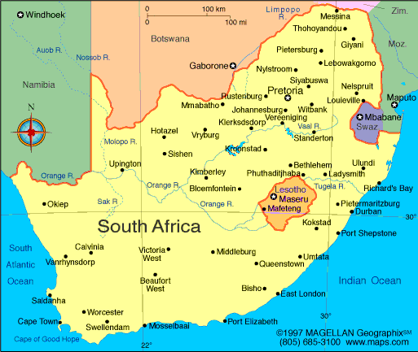
Only console is here
Hemopure(Biopure) –glutaraldehyde polymerized bovine Hb.
Licensed for clinical use in South Africa
Vet nary use –
FDA approved

Slide 12
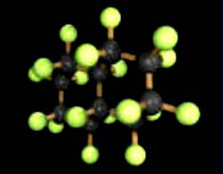
Perflouro carbons – abiotic
Perfluorocarbons(PFCs) are organic compounds similar to hydrocarbons – with carbon flourine bonds
Clear, odourless fluids, chemically very unreactive; linear, cyclic or polycyclic.
The stability of PFCs - strength of carbon-fluorine bonds.
Also responsible
for the inert nature of PFCs

Slide 13
What the curve is like ??

Slide 14
PFCs – properties
Synthetic liquids which dissolve large quantities of O2
•Also transport CO2, N2
•O2 easily extracted at tissues
•Stable, no chemical modification required, chemically inert
•Blood half-life dose dependent and limited by uptake by RES, eventually excreted from body by exhalation
•Easily sterilized, no disease transmission
•Low production costs, infinite supply

Slide 15
Microvascular effects
Emulsion particles 0.2μm diameter perfuse smallest capillaries (4 -5μm diameter) where no RBCsflow
•Augment local O2delivery much more than would be expected from ↑in O2content of arterial blood
•O2 in dissolved state →higher PO2in microcirculation →↑driving pressure for diffusion of O2into tissues
•O2 transported by PFCs is preferentially metabolised due to it’s excellent unloading characteristics

Slide 16
Problems with perfluorocarbons
Immiscible with plasma, need to be prepared as emulsions (egg yolk phosphatide)
•Require high FiO2 to dissolve adequate quantities of oxygen
•Flu-like symptoms observed in human clinical trials, delayed febrile reactions (due to phagocytosis by RES)
•Thrombocytopenia at higher doses

Slide 17
Various PFCs
safety (stroke) -?
Phase II trials
Discontinued; safety ??

Slide 18
How it is blood ??

Slide 19
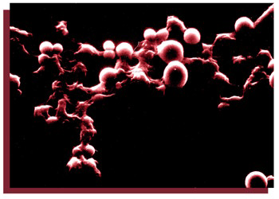
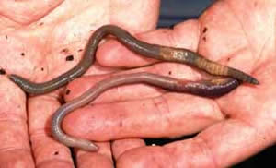
Research -
Encapsulation of hemoglobin in biodegradable polymer membranes
from worms
fibrinogen-coated albumin microspheres

Slide 20
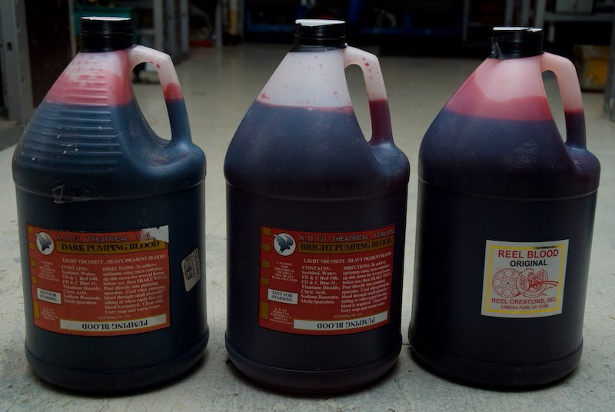
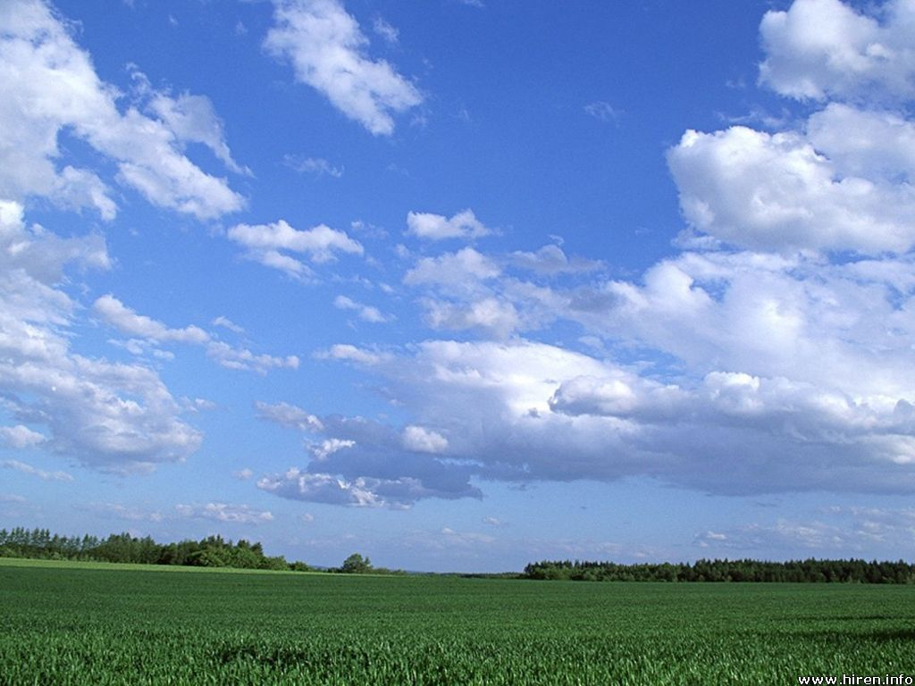
So near yet so far

Slide 21
Thank you all

