Slide 1
Barbiturates
Dr. S. Parthasarathy
MD., DA., DNB, MD (Acu), Dip. Diab. DCA, Dip. Software statistics-
PhD ( physiology), IDRA

Slide 2
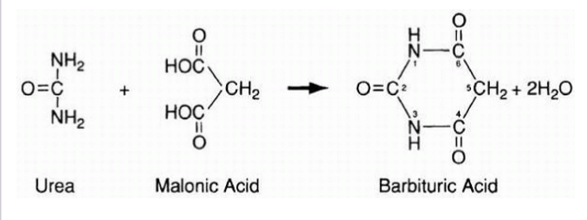
Synthesis

Slide 3
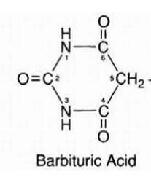
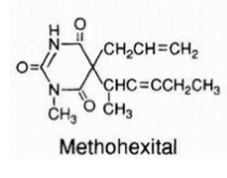
Barbituric acid is not hypnotic -substitution of 2 and 5 -

Slide 4
Thiobarbiturates
oxybarbiturates

Slide 5
Thiobarbiturates
Thiobarbiturates are
more lipid soluble,
has more rapid onset
and shorter duration of action.
Oxy barbiturates – excitatory phenomena

Slide 6
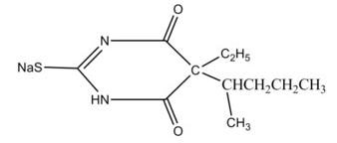
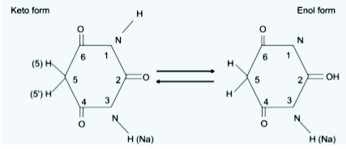
is acidic in nature due to the presence of H+ at position 1.
However, the Na+ salt (at position 3) of barbituric acid is water soluble yielding highly alkaline solution

Slide 7
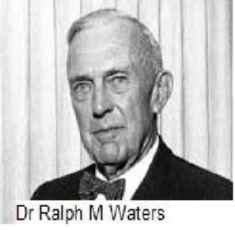
History
1864 – barbituric acid
1903 – diethyl barbituric acid
1934 – thiopental
Volviler , Tabern
Ralph waters
Lundy

Slide 8
Some history
Thiopentone – rapid action and rapid removal – they thought
High doses and deaths
Ideal method of euthanasia
War casualties in pearl harbor –tragedy
(7th December 1941)
Brodie and price – redistribution and not elimination – cause of termination of action
Don’t saturate the peripheral sites !!

Slide 9
UK or USA
Thiopentone
Or
Thiopental

Slide 10
Classification
Long acting
Short acting
ultra short acting
Not valid

Slide 11
Chemistry
Commercially available sodium thiopentone is a pale yellow, hygroscopic amorphous powder with a smell of hydrogen sulphide. ? garlic
The powder contains mixture of 6 parts anhydrous sodium carbonate as buffer (60 mg/g of thiopental sodium) to prevent precipitation of the insoluble acid form of barbiturate by atmospheric carbon dioxide.
For the above reason, it is prepared in atmosphere of nitrogen.

Slide 12
Chemistry
Yellow colour is due to the presence of sulphur molecule.
The powder is soluble in distilled water, normal saline and alcohol
pH of 2.5% solution is 10.5 which is highly alkaline
pKa = 7.60. – deep breath – alkali – less drug
Short acting , ultra short acting – classification – obsolete

Slide 13
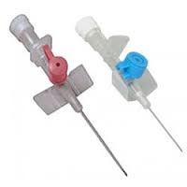
These highly alkaline solutions are incompatible for mixture with drugs in acidic solutions such as opioids, catecholamines, neuromuscular blocking drugs.
Block cannula
No pain on injection

Slide 14
The bacteriostatic properties of commercial preparations are due to their highly alkaline pH.
NO anti- bacterial agents.
The powder form is stable at room temperature indefinitely. The reconstituted solution (2.5%) is stable and sterile for 6 days (? One day ) at room temperature (22*C) and for 2 weeks at 4 – 8*C.
Throw out Cloudy solution.

Slide 15
Dosage and route
The usual IV induction dose of thiopental is
3 to 5 mg/kg in adults,
5 to 6 mg/kg in children,
6 to 8 mg/kg in infants.
(premedication and age !!)
Rectal – 6-10 mg / kg
methohexital 1.5 mg/kg
Calculated dose
Vs
titrated dose

Slide 16
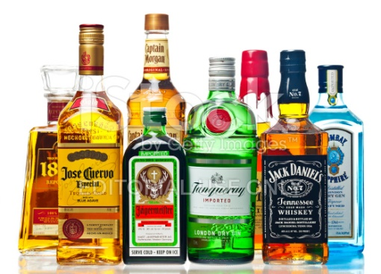
Acutely inebriated
Less dose
Chronic alcoholism
More dose
Loss of eyelash reflex
Deep sigh
Apnea
Tidal volume depression than rate

Slide 17
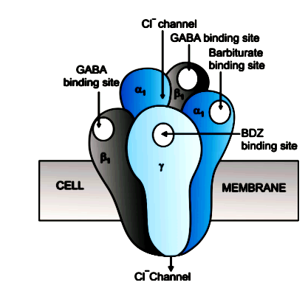
Mechanism
GABA A receptor –
Chloride channels
Hyperpolarization of nerve cell -----
Glutamate antagonism
Na channel blockade

Slide 18
Pharmacokinetics
Volume of distribution at steady-state (Vd): 1.7 to 2.5 L/kg; may increase to 4.1 L/kg during pregnancy at term and to 7.9 L/kg in obese patients.
Clearance – 3.4 ml /kg/min.
Protein binding: high protein binding, with albumin ranging from 72 to 86%.
Decreased protein binding due to hypoproteinemia (cirrhosis of liver) or other causes – more action

Slide 19
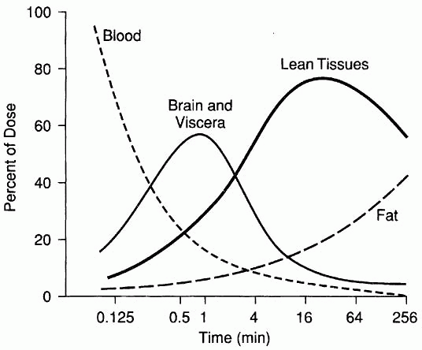
Redistribution
Onset
15 – 30 seconds
Duration - 5 – 10 minutes
Metabolized by the liver and mostly excreted as inactive products

Slide 20
Pharmacodynamics
Dose dependent depression of cerebral cortex, ascending reticular activating system and medullary centre resulting in sedation, hypnosis, anaesthesia, respiratory depression.
Decrease in Cerebral metabolic oxygen consumption,
Reduction of MAP ,CBF and ICP ( CPP is OK )
Anticonvulsant effect Isoelectric EEG, (not with methohexitone )
Antanalgesic effect

Slide 21
Neuroprotection
It has been suggested that barbiturates also possess “neuroprotective” properties secondary to their ability to decrease oxygen demand. Alternative explanations have been suggested, including a reverse steal (“Robin Hood effect”) on CBF,
free-radical scavenging,
stabilization of liposomal membranes,

Slide 22
Neuroprotection
experts have concluded that barbiturates have no place in the therapy following resuscitation of a cardiac arrest patient.
In contrast, barbiturates are frequently used for cerebroprotection during incomplete brain ischemia
(e.g., carotid endarterectomy, temporary occlusion of cerebral arteries, profound hypotension, and cardiopulmonary bypass).
15 mg / kg with 7 mg/kg/hour doses

Slide 23
Cardiovascular
Peripheral vasodilation
Myocardial depressant
Blood pressure falls
More with metho because tachycardic response is less
On beta blocker beware !!

Slide 24
Depression of ventilation
Decreased sensitivity of respiratory centre to increase in carbon dioxide.
Apnoea may be present in 30- 40% cases.
But laryngeal and bronchial reflexes are not much depressed in low doses
Laryngospasm and bronchospasm

Slide 25
Others
Decrease hepatic blood flow – not much
Enzyme induction
Modest decrease in renal blood flow
Placental transfer is present but acceptable
Decrease IOP

Slide 26
Clinical uses
Induction of anesthesia
Maintenance of anesthesia ( 50 mg / 12 minutes
Sedation
Increased ICP - 3 mg/kg
Anticonvulsant
Neuroprotection
Narcoanalysis

Slide 27
Truth serum
The maddening thing about Truth Serum, and the damage over the years, is that its conceptual originator, Dr Robert House, meant it to exonerate prisoners.
They spoke automatically and unthinkingly,
Find out truths

Slide 28
Contraindications
Acute intermittent porphyria (thiopentone induces mitochondrial enzyme D- aminolevulinic acid synthetase. As a result, production of heme is accelerated, and acute intermittent porphyria may be precipitated in susceptible patients, (paralysis, collapse )
2. Barbiturate allergy
3. H/O paradoxic excitation
4. Status asthmaticus:

Slide 29
Think before thio
Shock states
Stenotic valve states , Rt to left shunts
Hepatic dysfunction
Myxedema
Muscle dystrophies
On disulfiram
Thermally injured may need more

Slide 30
Intra arterial injection
Aberrant ulnar artery superficial to biceps tendon
The pH of 2.5% drug solution is 10.5 (strong alkali). When it is injected into artery and mixed with blood (pH= 7.4= less alkaline) it gets precipitated as solid crystals of thiopentone and haemoglobin.
local inflammation and blocks small arterioles, vasospasm due to local release of noradrenaline.

Slide 31
Intra arterial injection
Pain
Blanching
Edema
gangrene
No anesthesia
Five days for gangrene ??
5 % is very dangerous that’s why its prepared as 2.5 % or less

Slide 32
Treatment options
Stop injection
Leave the needle – dilute with saline
Inject local and papavarine intra arterial
40 – 80 mg
Inject heparin IV
Stellate ganglion block
Why not venous ??

Slide 33
Other side effects
Euphoria, vertigo, restlessness
Allergy
Immunosuppression
Hemolytic anemia
Tolerance and physical dependence
Localized muscle spasm and pronation – narcotics will lessen

Slide 34
Summary
Barbiturates – oxy and thio
Acidic but sodium salt – preparation vials
History – euthanasia and pearl harbour
Mechanism
Dosage and Redistribution
Effects
Indications
Contra indications
Side effects

Slide 35
Thank you all

